Slide 1
COMMUNITY CONSULTATIONS USING RECIPROCAL RESEARCH:
Session 7:
Evaluation and Celebration

Slide 2
EVALUATION
Did participants find this course useful?
Has everyone agreed about how the information collected will be used?
Notes:
Activity
The facilitators will undertake an evaluation of the course with the participants
This can be based around the expectations set by the participants on day one.
Ask did participants get what they wanted from the course/consultation
are participants clear about why the Consultation took place
is there an agreement with participants on how the information collected will be used?
Ask them to write comments, or to tell the facilitators about whether the expectations were fulfilled or not.

Slide 3
EVALUATION
In this consultation,
What was most useful? and why?
What was least useful? and why?
What other issues would you have liked to discuss?
Ideas for future training needs?
AND: Has everyone agreed about how the information shared in this consultation will be used?
Notes:
Activity
If possible have the list translated into appropriate languages and distribute the list to the participants.
It might include a more formal evaluation devised by the facilitators, or a standard evaluation from a participating organisation.

Slide 4
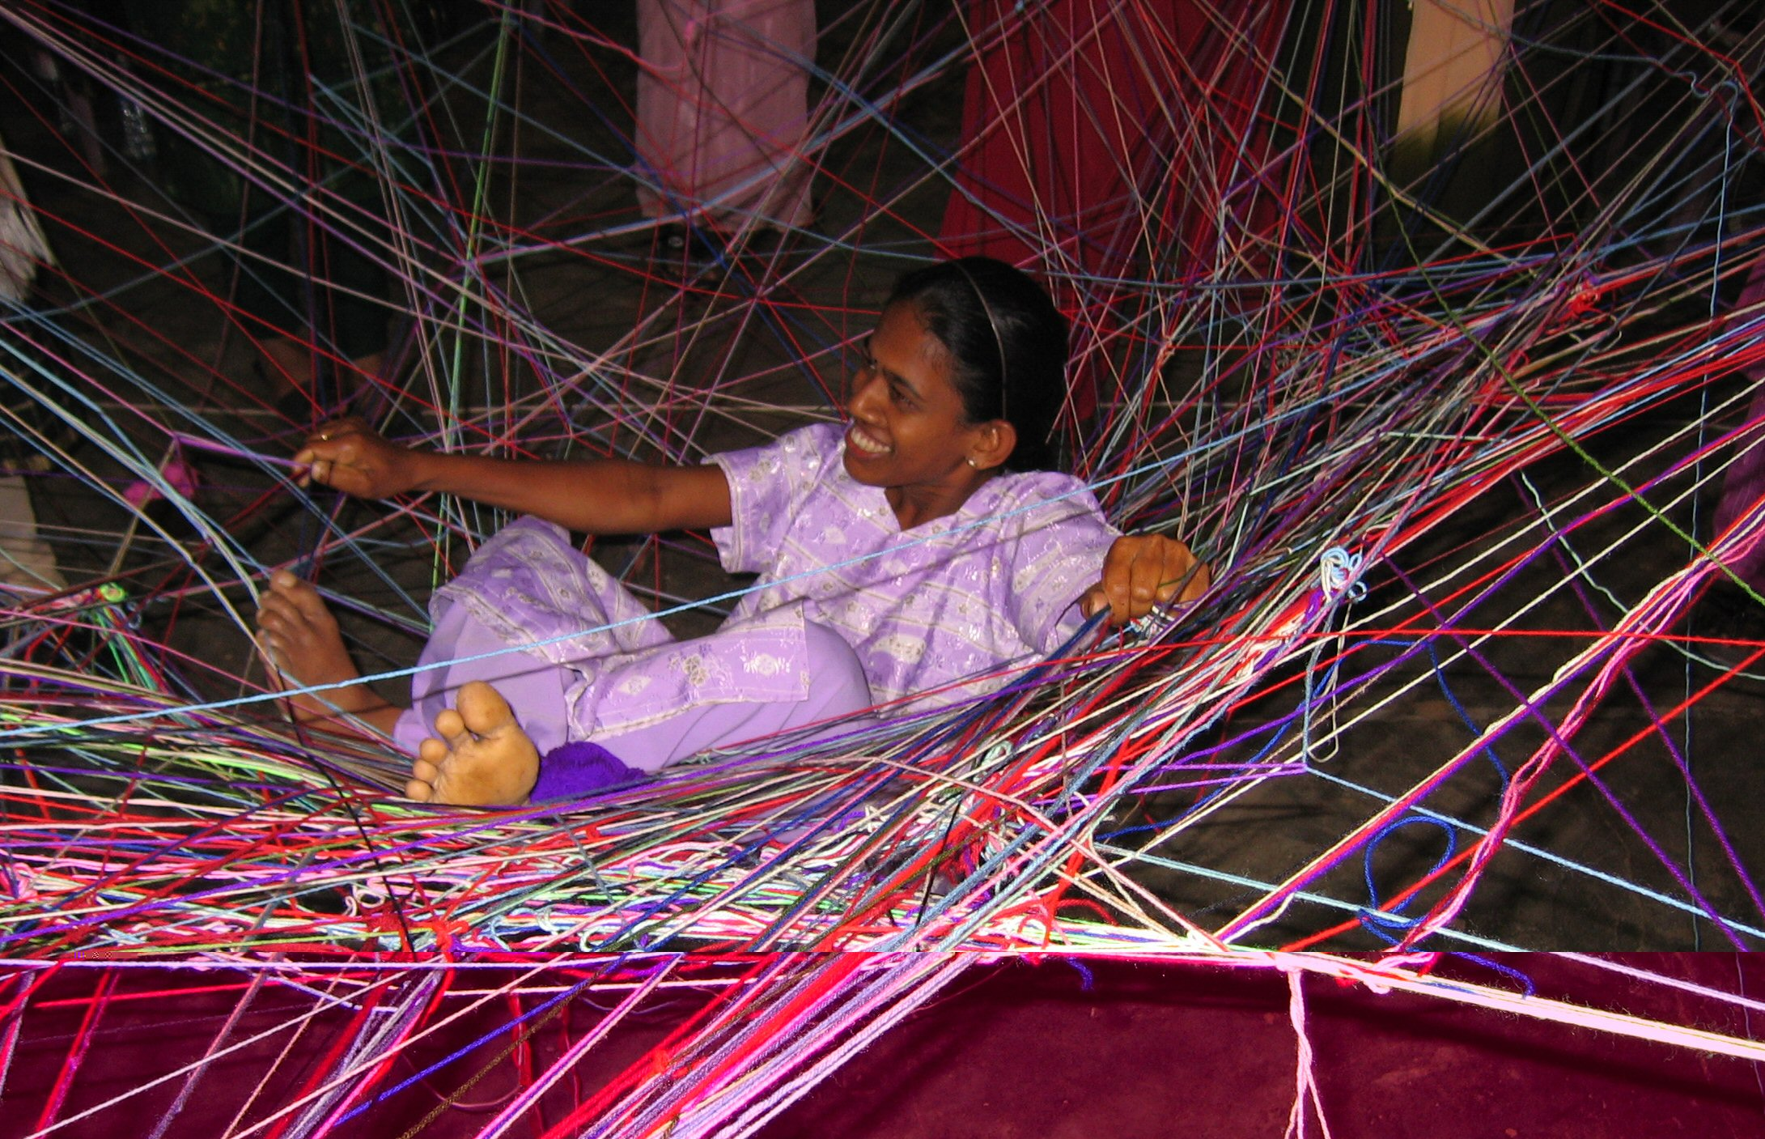
Celebration
After all the hard work it is important to finish with a celebration with the participants.
Notes:
Final Celebration
The closing activity should be one of celebration. Facilitators may have an activity which they prefer or might ask the participants for an activity which is appropriate to the community in which the training has taken place.
You may have a closing exercise which you particularly like. The participants themselves may have ideas about how they would like to finalise the training.
One nice closing exercise involves standing the participants in a circle and giving a ball of coloured twine or wool to every second and third person. Explain that every thread is a human right. Ask the participants to start throwing the balls of wool to each other shouting out a human right as they do so. When they receive the wool they keep hold of the part they catch, but then throw the ball of wool to someone else. As the wool is thrown backwards and forwards it forms a strong net – or network. You can explain it is the network of human rights formed by people working together.
If there is enough wool the net will be strong enough to support a person. Younger members of the group might enjoy being bounced gently on the net. It proves the strength of a network
Beware – they always insist that the facilitators join the fun and be bounced as well.

Slide 5
Congratulations on finishing the course
Good Luck when you use the materials yourselves.

