Slide 1
COMMUNITY CONSULTATIONS USING RECIPROCAL RESEARCH:
Session 4:
Story Circles

Slide 2
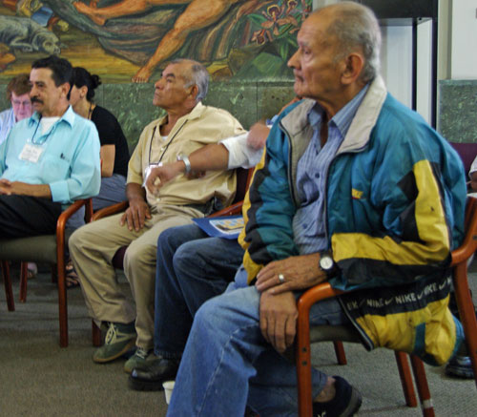
Sharing stories
We can learn a lot by sharing stories with each other.
They can be stories of survival and bravery, of risk and violence.
They can be happy, sad or funny stories.
By listening to each other we
can identify common issues
for community members
and service providers.
We can support one another
and celebrate our strengths.
Notes:
Ask participants to give examples of the role of storytelling in their culture and community.

Slide 3
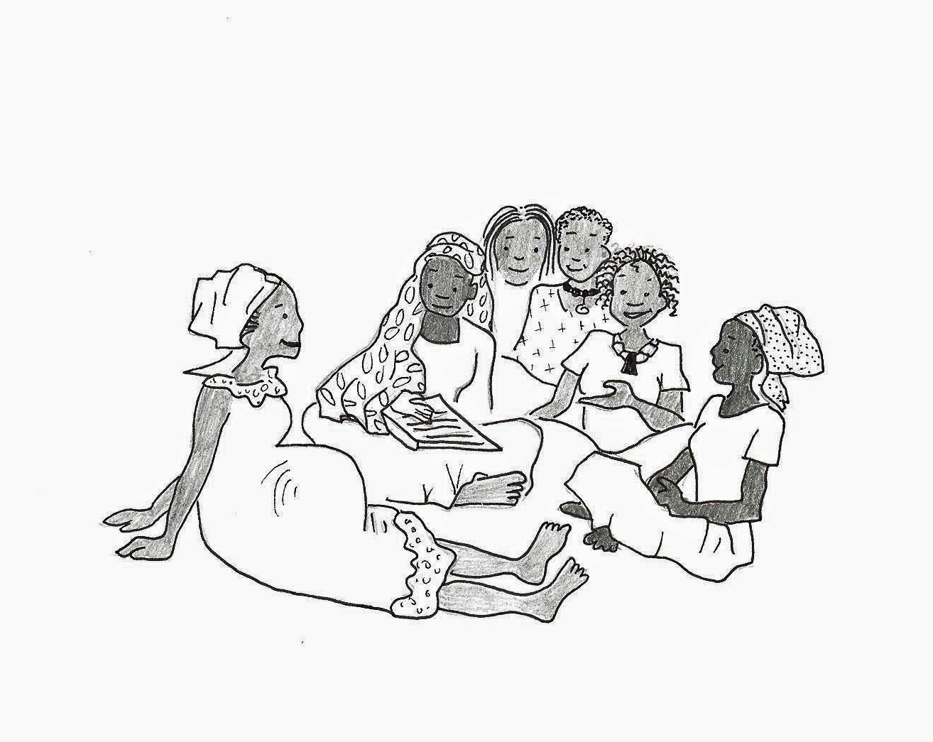
Story circles - using stories to identify issues of concern to a community
Story circles can be used:
To identify a range of problems experienced by individuals, families and communities.
For sharing information
For gathering information
As healing spaces
To validate experiences
For emotional support/befriending
Notes:
Identify any other ways stories are told.

Slide 4
Key things to consider in supporting Story Circles:
  Create a safe and friendly space
  Confidentiality
  Verbal / non- verbal communication
  Formulation of strategies to care for each other during and after the exercise
  Dealing with the issues that come out of the stories
  Not forcing anyone to join or speak
  Ongoing support strategies/befriending
  Peer support/worker debriefing
  Respecting participants choices, even if you dont agree with the choices
Notes:
Link this back to the confidentiality discussion

Slide 5
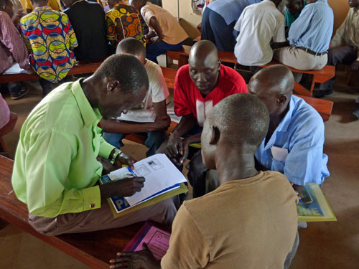
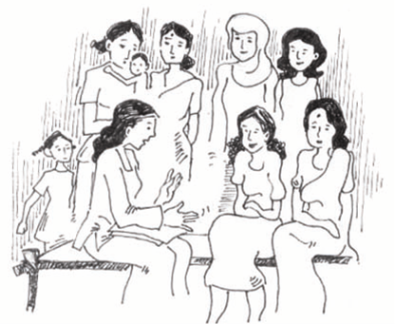
Listening, thinking and
acting to help communities
Notes:
Activity
Involve the participants in the analysis as the stories are recorded
As you listen to the stories consider
Are there common themes in the stories?
What lessons can be learned from the stories?
What are the problems which need to be addressed?
Use these questions as triggers for discussion
As the stories are told, make a list of all of the concerns which have been tabled
Record this on a flip chart
Turn the list into a report for the participants. If possible have this translated into the appropriate languages.
This list can be part of a presentation they might make to service providers in the future, or the basis for a report about how their community is coping.
At the end of the session ask participants to stand and hold hands. Affirm the strength of the people in the group to care for their community and to care for themselves while doing so.
If appropriate, light an oil lamp as an act of remembrance and respect for participants who have suffered.

Slide 6
Analysing the Stories
Listening,
checking,
responding
recording
23
Notes:
Give positive and supportive feedback to participants, demonstrating that you have listened and heard what they have shared with you.

Slide 7
Using Stories Effectively
Are there common themes in the stories?
What lessons can be learned from the stories?
What are the problems which need to be addressed?
Notes:
Draw up a list of things that have been learned from the stories which can be addressed in the course.

