Slide 1
COMMUNITY CONSULTATIONS USING RECIPROCAL RESEARCH:
Session 3:
Human Rights

Slide 2
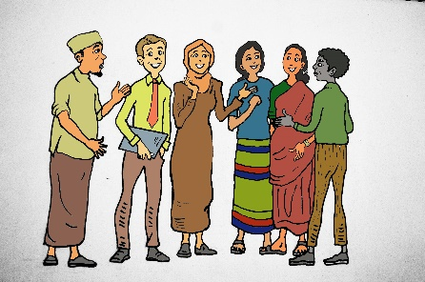
Human Rights: What they mean to us
Intellectual property of E Pittaway and L. Bartolomei; Reuse is permitted with author attribution
Notes:
Introduction
In this session we will explore what is meant by the Human Rights Framework.
Participants will be introduced to a range of Human Rights instruments and conventions. The material is presented in two formats, one can be used with people who have had some previous human rights training, and who would like to explore the meaning and value of the human rights framework, especially for people from the economic south.
The second is a graphics presentation which is useful to use with people who have had no, or little exposure, to the human rights framework.
You might use either sets of materials or both. It has been found that some people with previous experience also like to learn the simple presentation as they see the value of using it themselves to explain the human rights framework to other community members.

Slide 3
What is the United Nations?
Notes:
Presentation
Explain that the United Nations is the closest we have to a world government, and that international law is the set of agreed principles which are intended to govern the conduct of nations which are members of the United Nations. There are currently 191 member states of the United Nations. Important issues to cover are:
Unlike individual countries, or states the United Nations does not have a world army and it does not have any mechanisms for enforcing international law.
It is based on a system of trust and moral commitment to do the right thing. Sadly as we all know this often does not work.
The Security Council has the role of preventing and maintaining peace and resolving conflicts. Unfortunately we know that the United Nations is often unable to prevent or solve conflict, or to ensure the wellbeing of citizens in all countries.
While many criticize the United Nations for being ineffective, we must also realize that it is the servant of the countries which are members, totally dependent on them for funding. In fact United Nations Agencies do amazing work and the world would be a much harsher place without the United Nations.

Slide 4
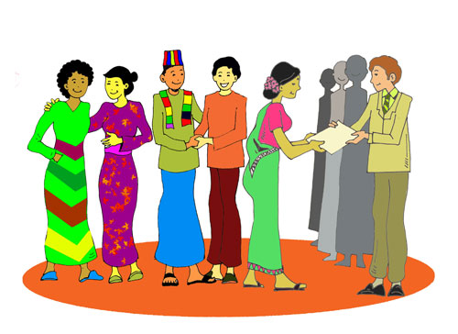
What is the Human Rights Framework?
The United Nations has produced many international conventions, declarations and legal documents which list our human rights.
These laws and documents together make up the human rights framework.
When Governments sign these documents and conventions they are agreeing to respect these human rights.
Notes:
Discussion continued:
Provide the participants with a brief overview of human rights principles.
Explain that there are many human rights conventions, laws and declarations which have been produced by the United Nations system which outline our human rights. This has been done with the support of NGOs as well as governments. These conventions and declarations make up what we call the human rights framework. When governments sign these conventions and laws they are committing to an international legal obligation to respect these human rights.
However, there is a major contradiction in the system. While Human Rights conventions and laws can not come into existence without the support of the UN and member states, not all states sign and ratify (implement) them and incorporate them into their domestic law.

Slide 5
What are human rights?
These are the rights to which all people are entitled regardless of race, gender, religion, age or any other social characteristic.
They are universal - this means they belong to everyone, everywhere.
Notes:
Discussion continued:
Elaborate on these points. Emphasize that human rights are universal – that means they are for everyone, not just for white men or rich women etc but for everyone, everywhere.
Challenge participants to consider groups who are normally excluded, such as prostitutes, homosexuals, people with a disability, people from minority religions.

Slide 6
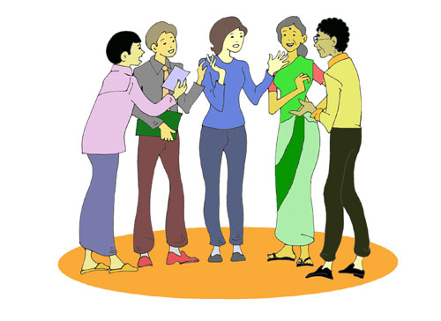
What are human rights?
They are indivisible, which means that all human rights are of equal importance.
They are inalienable, which means that although someone may stop you having them, they are still your rights.
Notes:
Discussion continued
Emphasise that rights are “indivisible” that means that all of the rights listed in the Universal Declaration, and in the two Conventions are of equal importance. For example without the rights to land then the rights of shelter and livelihood are also denied.
That they are “ inalienable” that is that no one can take them away from you – even though in some countries governments and others stop people from accessing their rights, these are still their rights!
For a simple and enjoyable game which illustrates these complex concepts, see notes for slide 22.

Slide 7
Universal Declaration of Human Rights
International Covenant on Civil and Political Rights
International Covenant on Economic, Social and Cultural Rights
Notes:
Refer to the Universal Declaration of Human Rights (UHDR) which was the first of these documents and was produced in 1946 when international governments came together after World War 2.
The most important thing that the UDHR states is that all people in the world are equal, regardless of race, gender, class or any other social difference. It lists the human rights to which all women, men and children are entitled. For example the right to live in freedom, the right to a nationality, the right to religious and cultural freedom. The right to work and the right to education, the right to food and water and shelter and the right to equality under law.
This is supported by the International Covenant on Civil and Political Rights and the International Covenant on Social and Economic Rights. These form the basis of all international law.
(You might be able to get copies of some Conventions either in the relevant languages, or in a simple format from the Human Rights bodies in the countries where you are working).

Slide 8
Economic, Social and Cultural Rights
Food, water, shelter
Health care
Education
The right to family
Access to income and the right to work
The right to religion
The right to enjoy the cultural life of your community
Notes:
Discussion
Introduce participants to the groups of rights which are included in the CESCR.
Suggested Activity:
Either as a brainstorm or a small groups exercise, ask the participants to list which of these rights they enjoyed in their home country, which of the rights they had in the refugee camp or setting, and which they enjoy in where they are now living?.

Slide 9
Civil and political rights
Access to the law
Political freedom
Access to income
The right not to be tortured
To live without persecution
The right to seek asylum
The right to work free from exploitation,
The right to life, to security, to freedom
Freedom of movement
The right not to be forced into a marriage
Notes:
Discussion
Introduce participants to the groups of rights which are included in the CCPR.
Either as a brainstorm or a small groups exercise, ask the participants to list which of these rights they enjoyed in their home country, which of the rights they had in the refugee camp or setting, and which they enjoy in where they are now living?.

Slide 10
Obstacles to human rights
Political challenges
State sovereignty & lack of political will
Ideological challenges
Universality versus cultural relativism
Individual or collective rights
Women’s and girls’ human rights
Gender neutral or gender blind
Notes:
Trainers Notes:
Spend some time discussing some of the barriers and challenges to the ability of people to access their human rights.
The political challenges
That is the unwillingness of many governments to honour the human rights commitments they have made to their people. Often governments will use the idea of “state sovereignty” that is the right of each individual government to decide what is best for its people as an excuse not to respect international human rights standards. Culture and religion are often used as excuses to deny human rights.
The ideological challenges.
Some governments and other groups use issues of culture and religion as excuses to not provide human rights to all their peoples. They often try to dismiss human rights as western concepts and claim that they are in conflict with so called “Asian or African Values

Slide 11
The Universal Declaration of Human Rights
Notes:
Women and Girls Human rights
One of the most common criticisms of the Human Rights Framework is that until fairly recently it did not recognise and support the particular concerns of women and girls. Although many argued that all of the conventions and laws were designed to protect the rights of women and girls as well as men and boys and were what is know as “gender neutral” they were in fact “gender blind”. That is they were really written for men and did not think about the special kind of human rights abuses and discriminations which face women. In particular there was little recognition of the impact of violence against women and girls, in particular rape and sexual violence in conflict situations and domestic and family violence. It was not until after 1993 that these forms of violence started to be recognised as women’s human rights violations.
Suggested Activity:
For slides 11 to 22
Ask the participants to list and discuss how they access these rights. This can be done either as a brainstorm or a small group exercise.

Slide 12
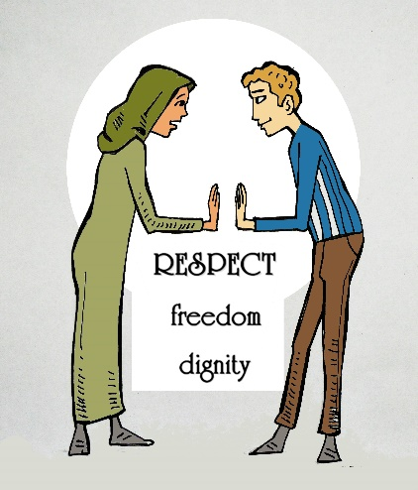
Notes:
Respect, freedom and dignity are overarching rights which impact on all others. If other rights are provided without respecting the freedom and dignity of recipients, then they are not receiving their full rights. An example of this is that of food being thrown off trucks and from helicopters to crowds in refugee situations, or post disaster, who then have to scramble and fight in the dirt to obtain some of what has been thrown. One could say that the right to food had been satisfied, but totally without respect and dignity.
Ask participants to evaluate whether the services they either receive or provide are given in a manner which respects freedom and dignity.

Slide 13
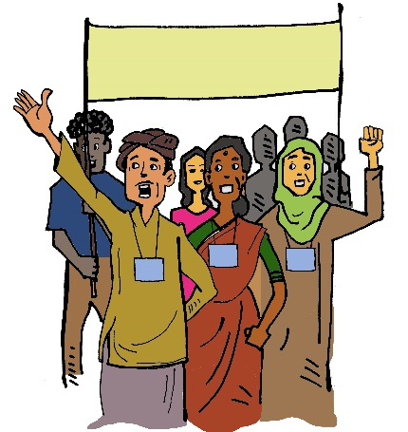
Autonomy and self determination
Notes:
This is another overarching set of rights. It includes the rights of communities to take part in the decision making about services and actions which will affect themselves, their families and communities.
Again, ask participants if these principles apply to services which they either receive or supply.

Slide 14
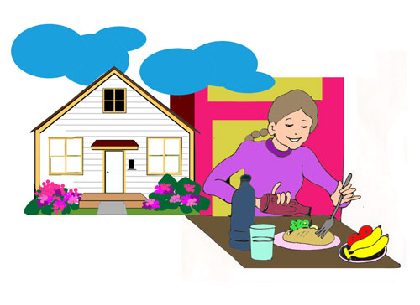
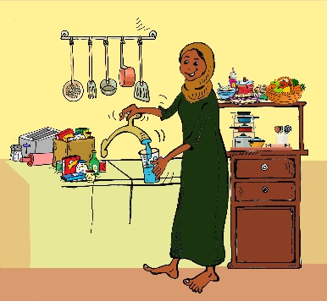
Shelter, food and water
Notes:
This slide depicts the right to food, shelter and water
Ask the participants to list and discuss how they access these rights. This can be done either as a brainstorm or a small group exercise.

Slide 15
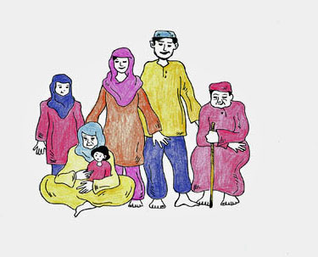
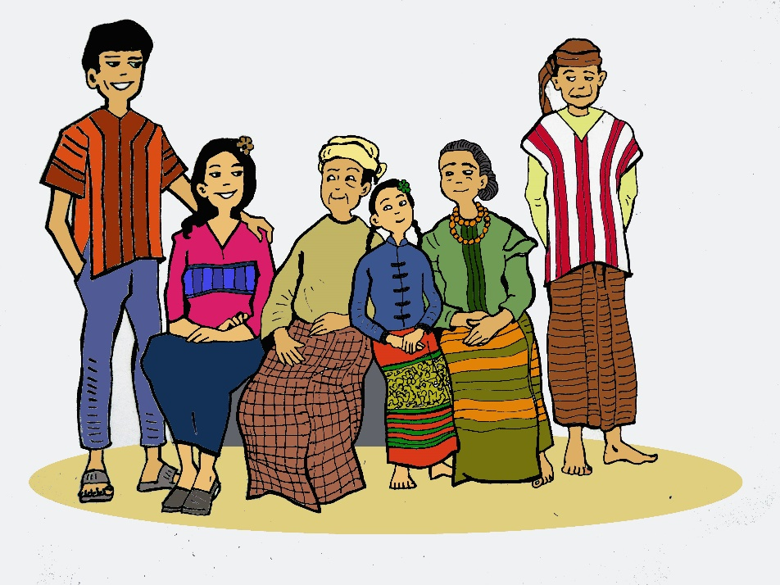
The right to live with family
Notes:
This slide depicts the right to live with family in peace and security
Ask the participants to list and discuss how they access these rights. This can be done either as a brainstorm or a small group exercise.

Slide 16
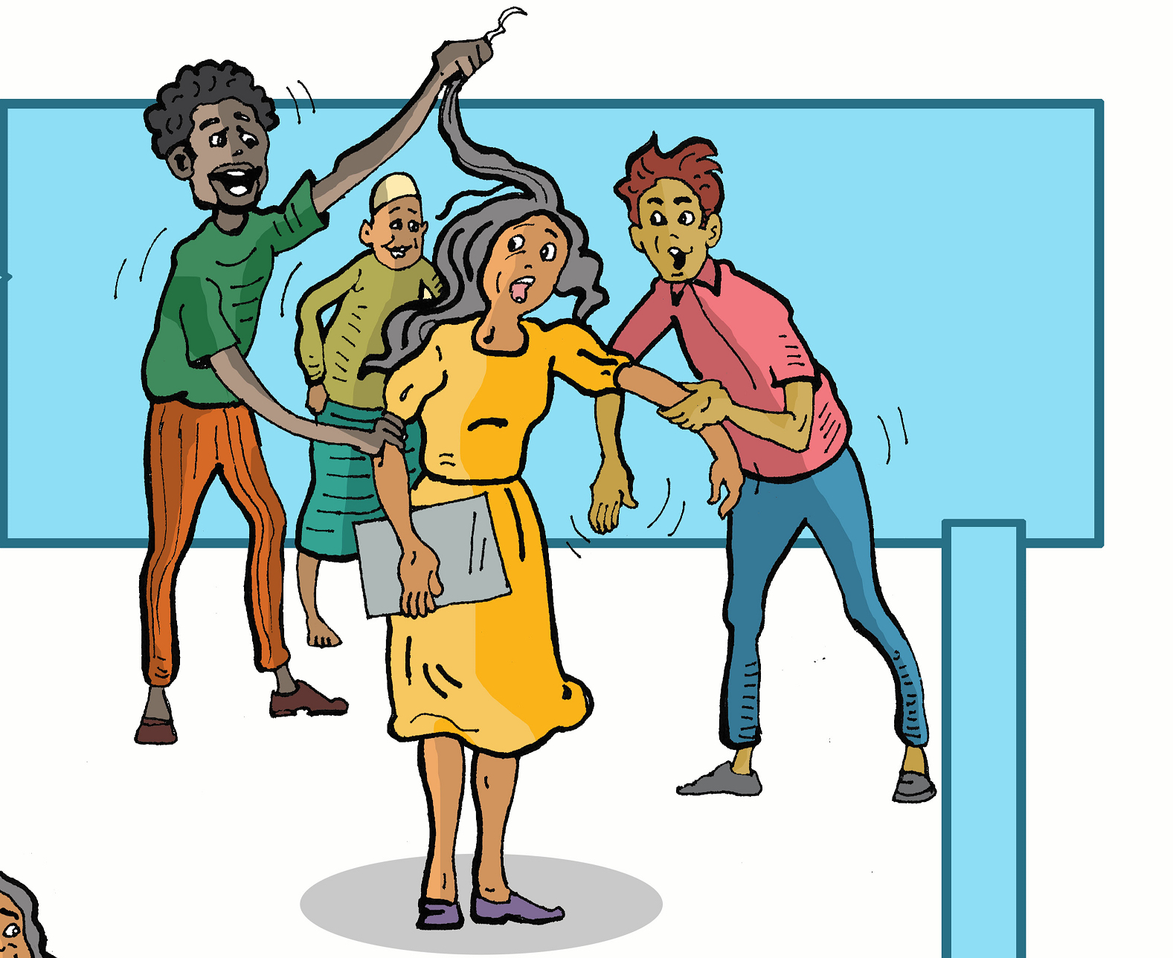
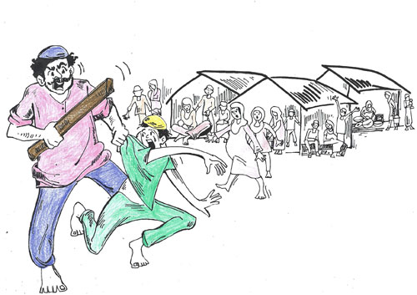
The right to live in freedom from all forms of violence
Notes:
This slide depicts the right to live a life free from any sort of violence
Ask the participants to list and discuss how they access these rights. This can be done either as a brainstorm or a small group exercise.

Slide 17
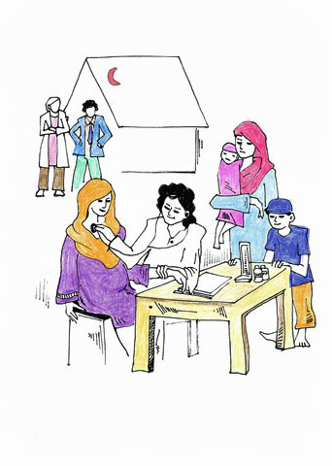
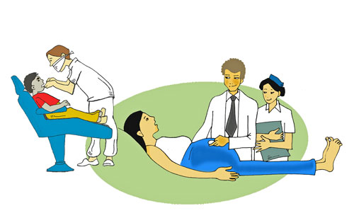
The right to good health care
Notes:
This slide depicts the right to good health and health services
Ask the participants to list and discuss how they access these rights. This can be done either as a brainstorm or a small group exercise.

Slide 18
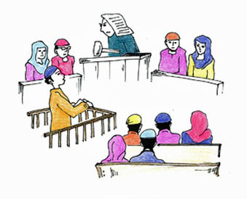
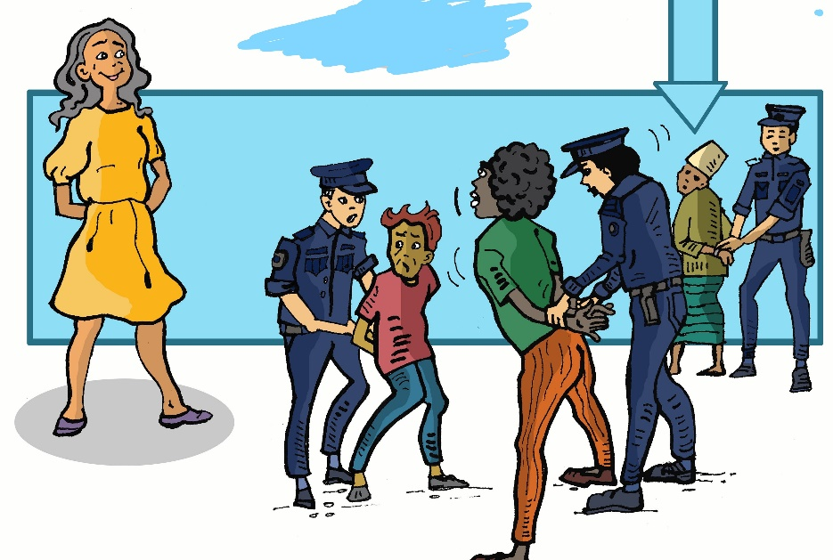
The right to full and equal access to the law
Notes:
This slide depicts the right to full and equal access to the law
Ask the participants to list and discuss how they access these rights. This can be done either as a brainstorm or a small group exercise.

Slide 19
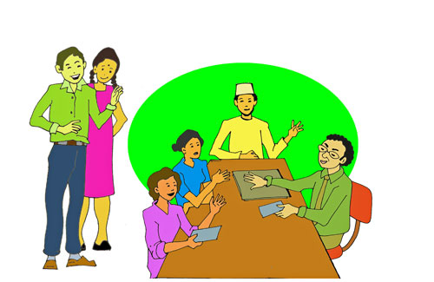
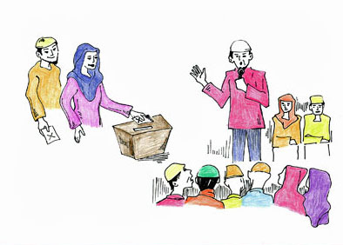
The right to freedom of speech
Notes:
This slide depicts the right to freedom of speech.
Ask the participants to list and discuss how they access these rights. This can be done either as a brainstorm or a small group exercise.

Slide 20
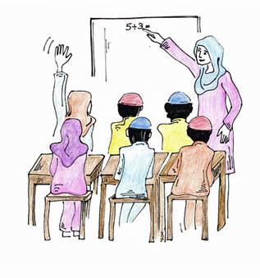
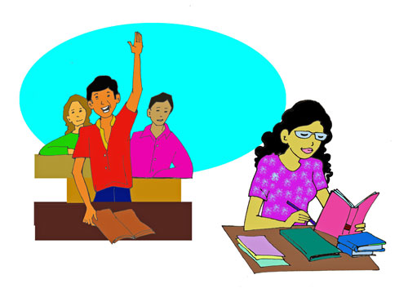
The right to education – for girls and boys - and also for life-long education
Notes:
This slide depicts the right to education for girls as well as boys, and also for life long education.
Ask the participants to list and discuss how they access these rights. This can be done either as a brainstorm or a small group exercise.

Slide 21
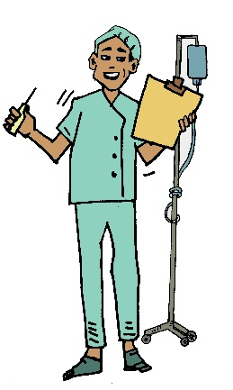
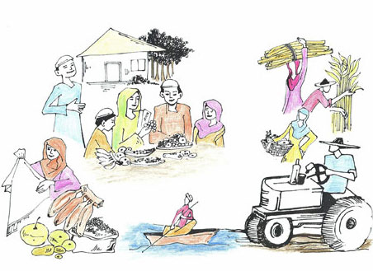
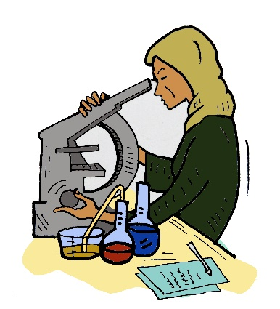
The right to social security, equal access to resources, and to work
Notes:
This slide depicts the right to social security and access to resources.
Ask the participants to list and discuss how they access these rights. This can be done either as a brainstorm or a small group exercise.

Slide 22
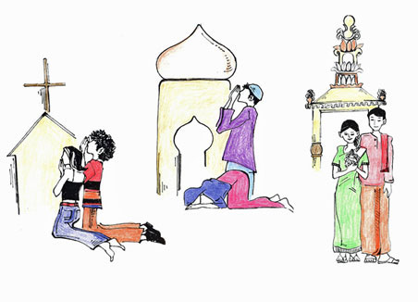
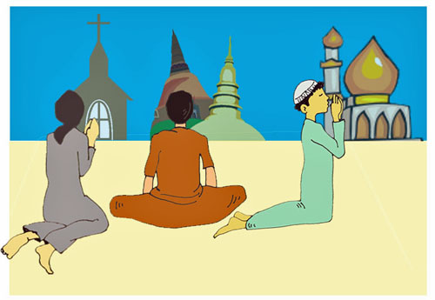
The right to freedom of religion and religious expression
Notes:
This slide depicts the right to freedom of religion and religious expression
Ask the participants to list and discuss how they access these rights. This can be done either as a brainstorm or a small group exercise.

Slide 23
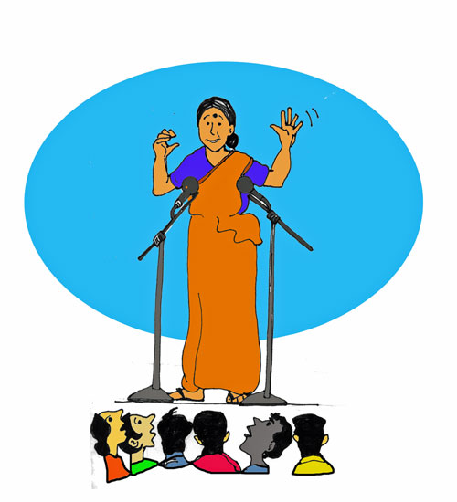
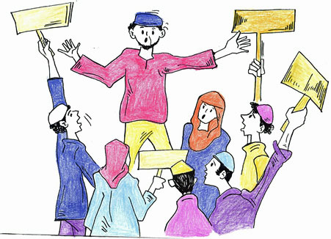
The right to political freedom and representation by both men and women
Notes:
This slide depicts the right to Political Freedom and representation by both men and women.
Ask the participants to list and discuss how they access these rights. This can be done either as a brainstorm or a small group exercise.

Slide 24
The human rights ‘necklace’
Each coloured bead represents a group of our rights.
The closed circle of the necklace symbolises the equal value of each right and the indivisibility and inalienability of rights.
Refugees are often given a packet off beads and twine to make a symbolic necklace of their rights as an exercise.
This story demonstrates what this can mean to them
Notes:
Why we teach human rights
This story tells how a group of women in Cox’s bazar used the xxx of the necklace to explain their hopes and dreams
The older woman was small but she stood tall facing the stage and the interpreter held the microphone for her. She started like this. ‘Good morning UNHCR and NGOs. I have pictures here ready to show about what we have discussed this week, but first, please look at me and you will see that over my burka I have a human rights necklace’. People looked surprised and confused; they wondered why she was talking about a necklace. Then she said, ‘Look at the women, they all have the necklace on’ and we looked and all of the women had their brightly coloured beaded necklaces on the outsides of their dusty, black burkas. She then said, ‘Look at the men, they are all wearing necklaces’ and every man had also put on a necklace. She said, ‘UNHCR and NGOs let me tell you about my necklace. These stand for all of our human rights. When I was a girl, back in my village in Burma, we had most of these rights. We had happy families, we went to school, we had enough food, we had water. We didn’t have all of the rights but we had a lot of them. Then the war came, we were persecuted, the military burnt our villages, raped the women, beat-up and killed the men. Horror came and we had to flee to Bangladesh. But we ran with our human rights neck-laces on our necks because we believed that in Bangladesh, we would have safety and we would have our human rights. She paused and looked hard at the dignitaries and said, ‘UNHCR and NGOs, this camp is terrible, it is dangerous and we are starving. Do you know what is happening to our human rights here?’ Then she lifted her hands to her neck and tore off her necklace. She pointed to the beads scattered across the floor and said, ‘This is what has happened to our human rights. UNHCR and NGOs, it is your duty to help us to pick up them up from the floor. We all want to wear our necklaces again.’ She then picked up her storyboard pictures and gave the presentation that she had done with the women (recounted by Eileen Pittaway, 2007).

Slide 25
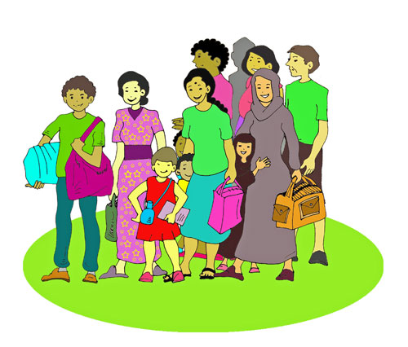
Refugees have rights!
Notes:
Note to Facilitators
There will not be time in this training course to do an in-depth coverage of all of the Human Rights relevant to refugees, IDP’s in camps or other specialised groups.
The following sets of slides about refugee, child and women’s rights are intended to introduce the idea that there are a broad range of human rights instruments and protections which are relevant to communities. If they are interested in pursuing these, it could be flagged for future training in the evaluation and training report.

Slide 26
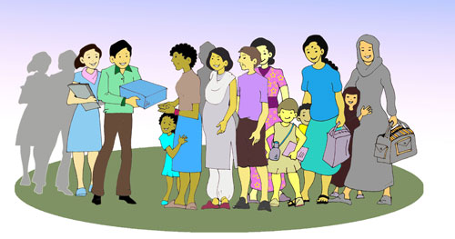
All refugees have a right to full protection from all forms of human rights violations.
Their rights are set out in the 1951 Refugee Convention, its 1967 Protocol (and the Universal Declaration of Human Rights).
Notes:
If you are working with refugees, discuss briefly the rights which refugees have under these conventions, the most important of which are the right to seek asylum in another country, and the right of protection from the international community.
Explore with the groups what the idea of “protection” means to them. Who do they think has the obligation to provide this protection? What is the role of UNHCR and the INGO’s and NGO’s in this task?
Discuss the fact that protection is a ‘right’ and not a charitable act. They have the right to expect an acceptable standard of services and to be treated with respect, even when resources are scarce. This is equally applicable in camps and upon resettlement in Australia
There is an obligation on Governments which are members of the United Nations to provide this protection to refugees.
There is a constant debate about how this should be achieved.
Mention that many IDPs also fall into this category. If appropriate ask the participants to share some of the reasons why they were forced to leave their countries.

Slide 27
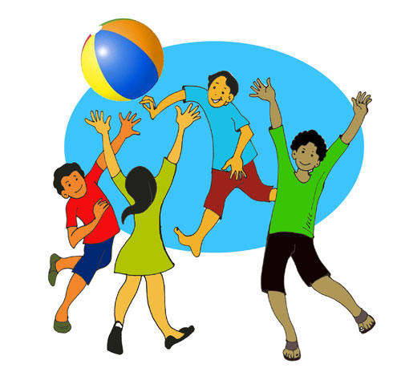
Children have rights!
Their rights are set out in the Convention on the Rights of the Child (CROC) (and the Universal Declaration of Human Rights) .
Notes:
Note to Facilitators
It is useful to also make participants aware that people under the age of 18 are considered by the United Nations to be children, and that Children also have special rights under the Convention on the Rights of the Child (CROC).
All but two nations in the world have signed CROC. They are the USA and Somalia.
If there is time, discuss each right with participants, and explore how these right are
Experienced in the refugee site in which you are working.

Slide 28
Children’s rights
The right to go to school
The right to be with their parents
The right to have fun
The right not to have to work like an adult
The right to go to a doctor
The right to protection from sexual abuse
The right to be protected from drugs
The right to be safe – to live and grow in safety
The right to not be recruited as a soldier or to fight in a conflict
Notes:
CROC is often available in pictorial format from Human Rights Organisations or on the web.

Slide 29
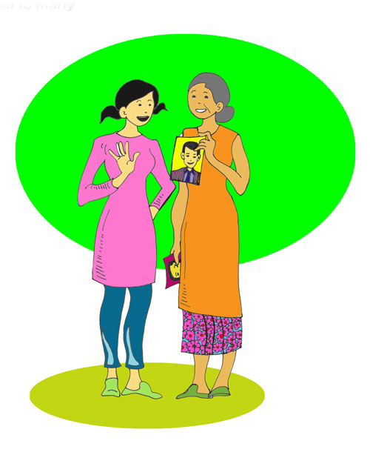
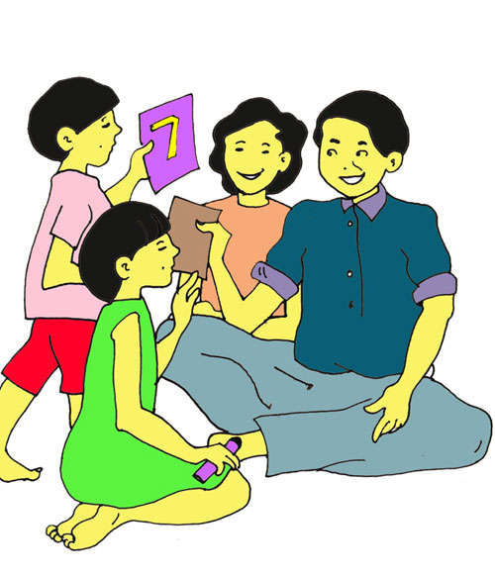
The right of every child to live in security with their family.
Notes:
Discuss what each right means to participants, and if they currently enjoy them

Slide 30
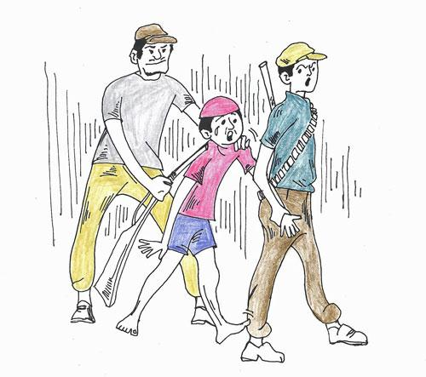
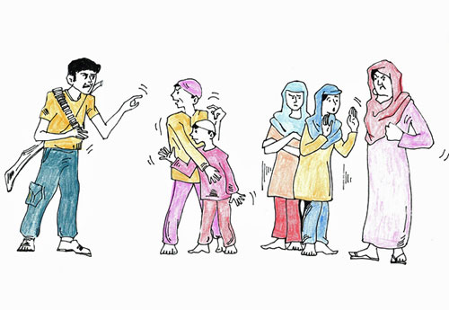
The right of every child not to be conscripted as a child soldier or sex slave

Slide 31
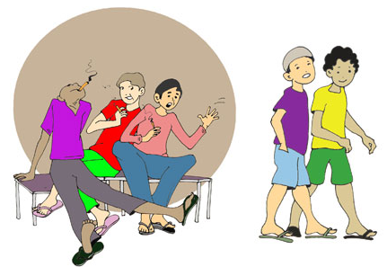
The right of every child not to be exposed to drug taking or drug trafficking

Slide 32
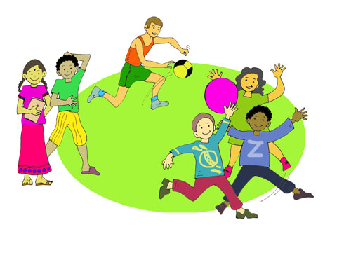
The right of every child to freedom from formal work and to leisure time

Slide 33
Women have rights!
Their rights are set out in the Convention to Eliminate Discrimination against Women (CEDAW) (and the Universal Declaration of Human Rights)
Notes:
In this session, you will introduce participants to CEDAW.
It is important to stress that these rights are in addition to the rights contained in all other Conventions.
The next four slides provide a very simple introduction to CEDAW and are designed to trigger discussion, especially if the participants have had no previous exposure to the Human Rights Framework.
If available, distribute copies of CEDAW in appropriate languages
There are background notes in the manual, which can be translated, copied and given to the participants if applicable.

Slide 34
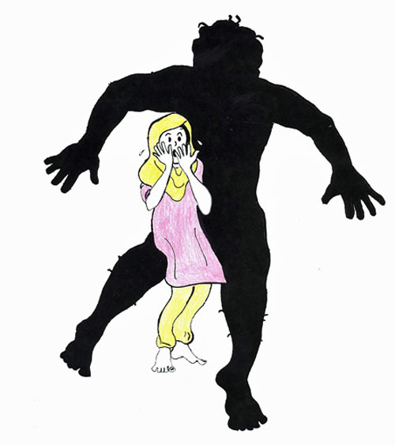
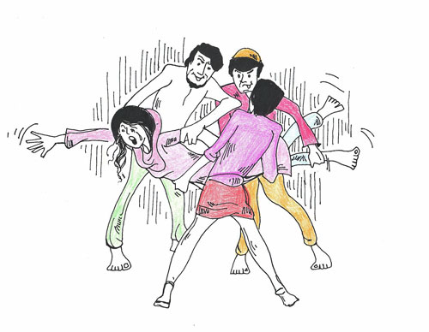
The rights of women to be free from sexual and gender based violence and to live free from fear of sexual and gender based violence
Notes:
What is happening to the woman in this slide.?
Discuss the fact that women should be free from the FEAR of violence, as well as from the act of violence.
This includes violence in the home and from social violence, it includes the violence of trafficking and forced prostitution.
Explain that these rights are detailed in CEDAW.

Slide 35
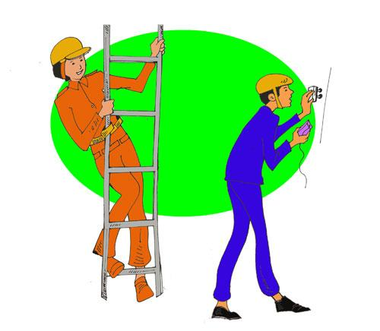
The right of women to work wherever she wants to, in traditional and untraditional forms of employment
Notes:
This slide can be used as a trigger for discussion on the right of women to work wherever she wants to, in traditional and untraditional forms of employment.

Slide 36
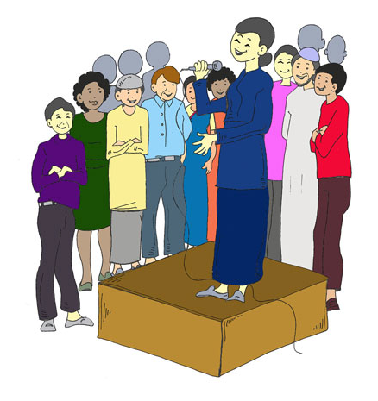
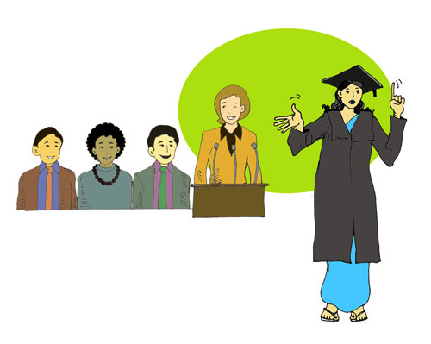
The rights of women to take part in decision making and political processes, and the right to life-long education.
Notes:
This slide can be used to trigger discussion about the rights of women to take part in decision making, in political processes and the right to life-long education.

Slide 37
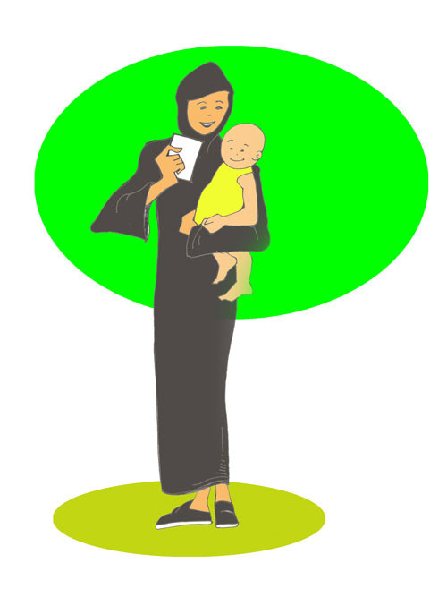
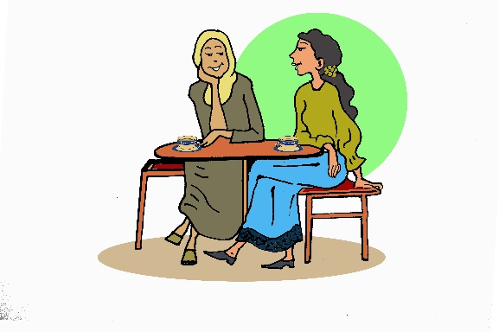
The right of women to choose their own partner and sexuality and to not be forced into marriage for any reason.
Notes:
If there is time, discuss each right with participants, and explore how these right are
Experienced in the refugee site in which you are working.
If participants are reluctant to discuss the rights of members of LGBTQI+ communities, gently explore why this is, and what can be done to address I t.

