Slide 1
EFECTIVE
COMMUNITY CONSULTATIONS USING RECIPROCAL RESEARCH:
What is Community Consultation?
Notes:
This set of slides was developed after the facilitators then realized that they were working on the assumption that participants in this sort of training would all have some basic knowledge about community development, which was not correct. Some participants did not have experience in getting a group of people to meet together, or how to run community development activities.
These slides were developed for groups who do not have recent training or experience in community development or who are not familiar with actively consulting with community members.
The aim is to enable people to run successful and enjoyable consultations. It challenges the idea that leaders know best and have all of the power, and that a brief focus group is not real ‘community consultation.
It is about fostering participation.
There are not detailed slides-notes for all slides. Use them as discussion points to engage participants, or as a basis for small group exercises if time allows.

Slide 2
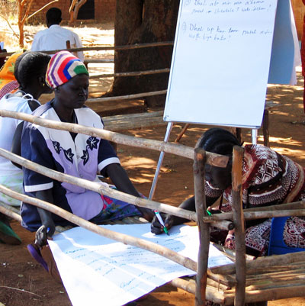
Community Consultation underpins real community development.
It is participatory, which means that the community articulates its own concerns and can identify appropriate responses and solutions.
If done well, it can bring about the empowerment of community members.
Notes:
We suggest that the facilitator goes through the slides with the group before starting on the other training materials. We have not included many activities, because of the time factor. If the facilitator feels that the group with whom they are working needs more input on any of the areas covered in the slides, they will need to they identify specific training materials on these areas.
It is about ensuring that the voices of ALL refugees and displaced women can be heard.

Slide 3
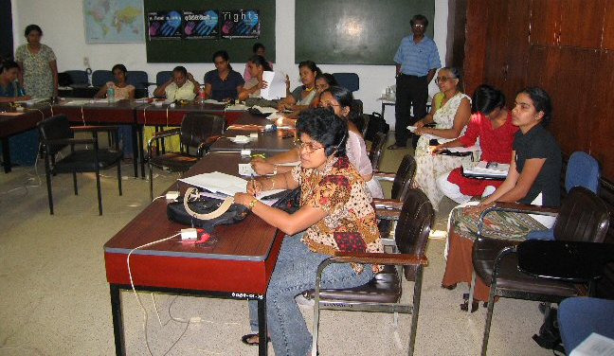
It means designing and running programs which give people from the community power over the decisions which affect their lives.
It gives them some control over of the services which they need to strengthen and enhance their capacity and the capacity of their communities.
It means working in REAL partnership with communities.
Notes:
See Module 9, Effective Partnerships

Slide 4
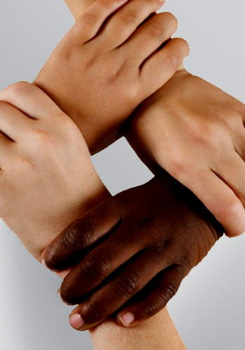
Partnership between refugee
communities and Service Providers
What does ‘partnership’ mean in a human rights framework ?
It involves recognising what each group brings to the relationship and working out together how best to use these resources.
Notes:
As above

Slide 5
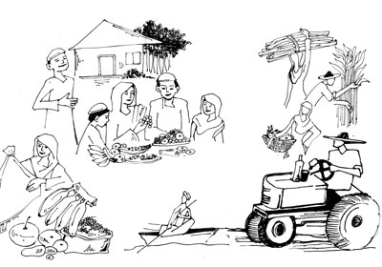
Some of the things individuals and communities bring include:
Resilience
Determination to succeed
Knowledge of what they need to succeed
Effective cultural traditions and practice
Previous qualifications and skills, both practical and professional
Survival skills
Prior knowledge and wisdoms
Notes:
See Succession Planning – Assets and Needs Audit slides, Module 12 for more detail.

Slide 6
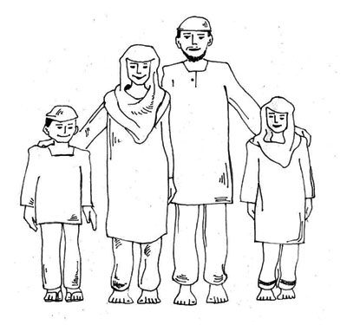
Some of the things individuals and communities bring include:
Hopes and aspirations for themselves and their children
Commitment to other community members
Strong loyalty to extended family, and orphaned children
The need to participate in society
Community structures
The desire to work
Many other attributes
Notes:
As above

Slide 7
Service Providers can offer:
Support and friendship
Access to a broad range of social services
Advice and guidance during periods of change, or when facing problems
Some assistance with funding for community meetings and projects
Information and training
Explanations about wider cultural and social expectations
Notes:
As above.

Slide 8
Service Providers can offer:
Legal information and advice
Facilitating community development and advocacy
Assisting communities to have their voices heard by those in power
Responding to problems which may emerge respect and recognition of community capacity and capabilities
The opportunity for individuals and communities to contribute to their society
Notes:
This information should be collected through a process of consultation, with the community and with other stakeholders.

Slide 9
Good Consultations lead to Empowerment
Community members feel as if they have ben listened to and their issues heard.
Notes:
This is easier to say than to do.
When poor quality consultations occur, with little or no follow up, communities become cynical and disappointed. They are disempowered.
A good leader can change this!

Slide 10
Empowerment leads to
increased self esteem.
Empowerment is one of the most potent forms of protection that there is, and is one of the keys to strengthening communities.
This is particularly true in situations where people have experienced torture and systematised sexual abuse.
Notes:
Good consultations can be an important stepping stone.

Slide 11
Power is linked with decision making.
If we are not able to make decisions we feel powerless and frustrated.
If we can make decisions about things which affect us, then we feel as if we have some control over our life.
Notes:
Ask participants how they feel when they are not able to make decisions about their own lives.
What would make a difference?
Good leaders can ensure that community members have an opportunity to make some decisions about the services they offer through RLOs.
They can define their needs, and suggestion solutions.

Slide 12
Working with the community
Any program that aims to meet the needs of disadvantaged individuals, groups or communities must first encourage
ACTIVE PARTICIPATION.
The idea of “participation” is that service providers work WITH the client group, rather than FOR them.
Notes:
This takes really good communication as well as trust.
The leaders have to be prepared to share their power.
For more information on power sharing, see Module 10, The Power of Privilege.

Slide 13
Participation means that client groups themselves set the aims and objectives of new services and programs and decide what is the measure of effectiveness.
It acknowledges that they have skills, knowledge and experience about their own problems and the best solutions for them.
Notes:
As above.

Slide 14

Participation also provides education, as in sharing we learn from others.
It says that we do not regard ourselves as the experts who know what is best for them.
Education through
Participation !
Notes:
As above.

Slide 15
Active Listening
Flexibility
Willingness to be open and honest
Ability to share power
Notes:
These are attributes needed to run good consultations.

Slide 16
Ability to delegate responsibility
Non judgemental attitudes
Gender sensitivity
Cultural and class sensitivity
Notes:
… and these.

Slide 17
Community Consultation
Why are we doing it?
What does it mean?
How should it be done?
Notes:
Often, communities are suspicious of consultations.
Leaders have to be very clear about how to do it well.
Ask if people have had experiences of bad consultations – what did they not like?
Can you offer any examples from your experience?

Slide 18
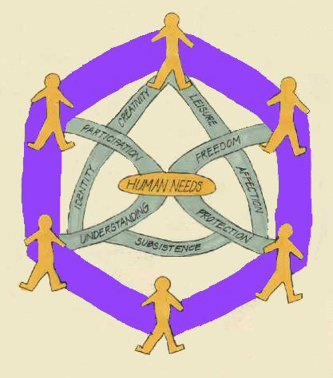
Needs Based Analysis
“Finding out what
communities
want and need”
Notes:
Needs based analysis is a formal way of asking what people need.
Can you offer any examples from your experience?
Do participants have any examples of good consultations, which they felt were worth while?

Slide 19
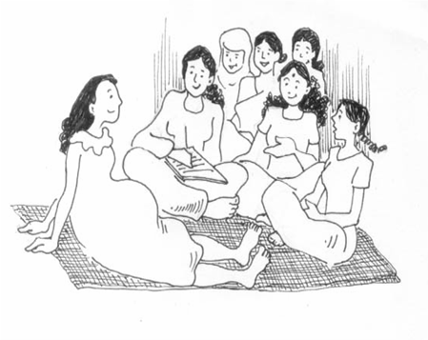
Needs as defined by program recipients
Notes:
In small groups ask participants what they need to know about community consultations.
Compile a list on a flip chart, which can be used for planning a consultation.

Slide 20
The importance of data collection
and dissemination for:
advocacy
fund raising purposes
Notes:
One of the important things about good consultations is documenting all of the discussions.
This is evidence for future actions.
What other things do participants think can the data be used for?
An example is for compiling a history of what their community is experiencing.

Slide 21
The importance of data collection
and dissemination for:
the individual,
the community,
addressing the problems identified.
Notes:
It is important to explain and explore the importance of data collection with participants and to seek their permission to compile it.
Refer back to the Confidentiality Session for rules regarding this.

Slide 22
BEWARE !!
If not done carefully, this can be seen as:
an invasion of privacy
a trick or trap
a waste of time
It can destroy trust rather than build it
Notes:
As above.

Slide 23
Once you have found out what it is that the people need and want most, then you have to work with the community to see what is realistic and achievable with the resources that you have available.
Notes:
This could form the basis of Program Design, and applying for funding.
It is important never to promise anything that cannot be delivered.

Slide 24
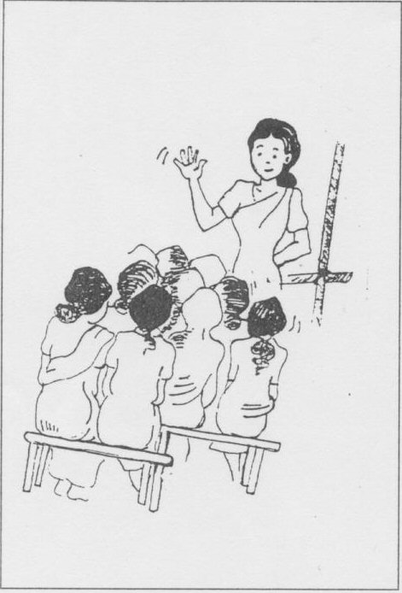
Forming a group.
Before you start a group it is a good idea to get together informally with interested community members and other people involved in the field and discuss what you would like to do.
Find out about groups which already exist.
Decide if a new group is needed.
Notes:
Starting a new groups is a good idea, but make sure that it is something that people want.

Slide 25
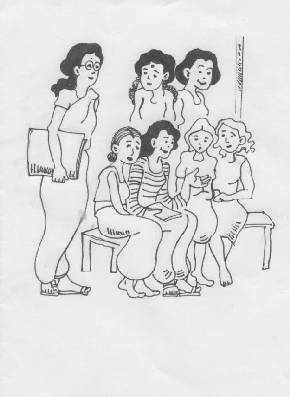
Starting a new group.
Planning a first meeting:
Speak to as many people as you can - invite them personally.
Create an attractive invitation to follow up the verbal invitation.
Notes:
Make sure that people feel that they are really welcome and that you want to hear from them.

Slide 26
Choose a date and time carefully
Make sure that it does not clash with other events or activities that group members may wish to attend.
If necessary organise transport for people.
Make sure that there is child care and interpreters are available if needed.
Notes:
It is no use arranging a meeting to suit yourself, if no-one else can come at that time. Be sensitive about the things that people have to do, such as collect rations or water.

Slide 27
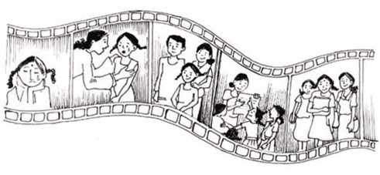
A good guest speaker
A video
An activity that is culturally appropriate to the group.
Notes:
What might tempt them out if they are tired or reluctant to leave their homes?

Slide 28
At the end of the first meeting, make some plan of action based on what people would like to do, collect names and addresses if the community members are willing to give them.
Make a time and place for the next meeting.
Notes:
If there is no follow up, people will wonder why you bothered to ask them questions.
You might ask yourselves the same question! Consultations should be a first step towards action, and people need to know what you have done with the infromation they volunteered.

Slide 29

What on earth is this all about?
Some community members will never have been consulted by service providers before.
They will not understand at first what it is all about.
Be prepared to take some time building confidence and trust.
The time taken at the beginning of the project will be well and truly repaid by the successful functioning as it gets underway.
Notes:
Be patient, and be prepared to explain the aims of the consultation in simple language and clear short sentences.

Slide 30
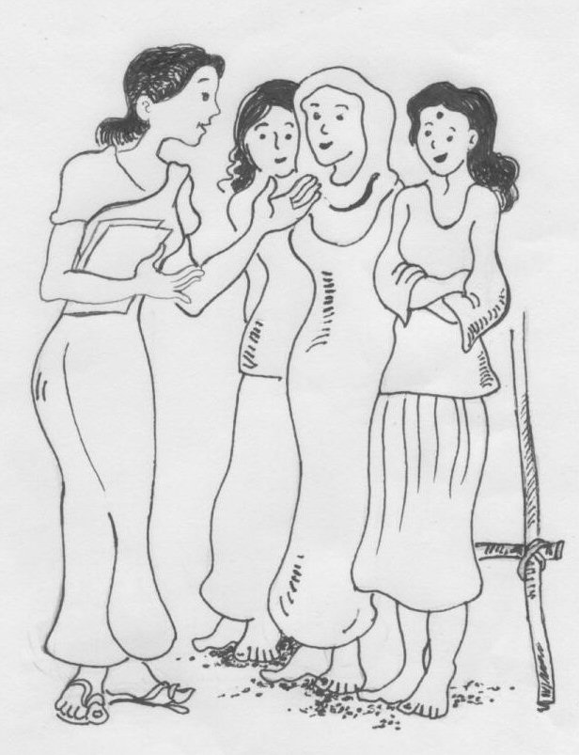
“How can I help? I am not educated.
I don’t know what to do.”
Everyone can be involved. Community members have skills, knowledge and experience.
They usually KNOW what they need, but often do not feel confident enough to express these needs
Notes:
Make sure you make people feel confident to speak out from their own experience and do not feel intimidated by others who may have a higher level of formal education.
See Reciprocal Research material in the “Additional Materials”, in particular the Human Rights, Matrix and Storyboard sessions to help with this.

Slide 31
OWNING A PROCESS THROUGH ACTIVE PARTICIPATION
Community members must be given every opportunity to plan and manage projects which meet their special needs.
The process must be consultative and ‘transparent’.
All stakeholders must be invited to contribute their ideas and to participate.

Slide 32

Ensuring that men and women from the community are supportive of the services and projects and not threatened by them:
How are you going to involve men so that they are
supportive of programs, without trying to take them over?
Notes:
See Including Refugee Men, Module 7 in this resource kit.

Slide 33
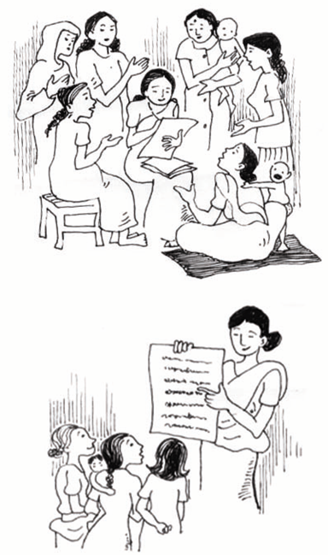
When people decide to work together as a group, they also want to understand each other.
Active listening means letting others express their opinions and feelings without interruption. This is not as easy as it sounds and often needs special training for the group.
This is something you may have to put into your work plan or be one of the services which you provide.
Notes:
Good communication is critically important and you may need to get some additional training for your group about things such as Active listening and conflict Resolution.

Slide 34

CONFLICT RESOLUTION
Conflict always happens in groups and in itself is neither negative nor positive.
Dealing with conflict can be a positive experience and inevitably leads to change -often for the better.
If a conflict or a difference of opinion arises within a group it is important to talk about it openly.
This way people learn respect for each other. Everyone knows where they stand.
.
Notes:
As above.

Slide 35
SUCCESS
Think of 'success' as a journey and adventure rather than a particular destination.
Notes:
Good luck and enjoy the session.

