Slide 1
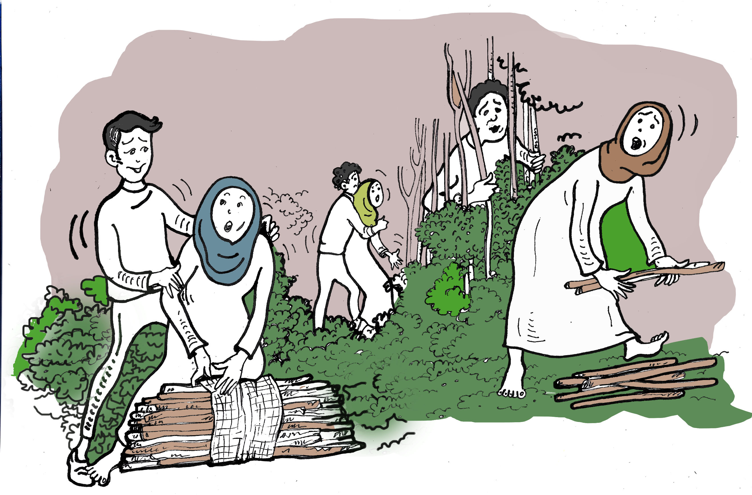
Session 5
Identifying the impact of Sexual and Gender based Violence on Refugee Women and girls
Presented by Dr Linda Bartolomei and
Adjunct Professor Eileen Pittaway
Forced Migration Research Network UNSW
Notes:
Facilitators Notes
Please read the background notes on this module before conducting the training.
If the material is new to you, it could be useful to invite someone familiar with the issues to co-present with you.
We continue to use the term SGBV, despite the fact that it is now more common to use GBV, on the grounds that GBV incorporates all forms of violence against women. While we fully accept this premise, in particular in academic and gender sensitive spaces, we have found that removing the word Sexual from Sexual and gender- based Violence has enabled policy makers, often male, and people who for some reason prefer to deny that the sexual abuse happens, to ignore the fact that the majority of refuge women and girls experience endemic sexual violence. If it is not mentioned, it is not addressed.
When running the session, be hyper vigilant in watching participants in case the material triggers negative reaction for some people.
Let participants know that they must feel free to leave the session if it is too upsetting for them.
If possible, have someone available to debrief people if necessary. (This happens very rarely)

Slide 2
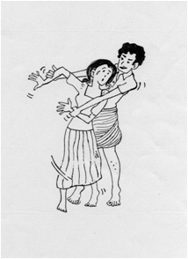
The Aim of the Session
To identify all of the barriers to participation caused by SGBV, or fear of SGBV, in any given site
“Violent conflict has an enormous and traumatizing impact on people and societies, and people know the difference between war and peace very well. They resent researchers who sanitize their situation and euphemistically speak of conflict, food insecurity and gender-based violence when they really mean war, hunger and rape” (Hilhorst 2018:7).
Notes:
Suggested time needed to run the full module. The material can be introduced in a presentation of one hour, with an additional two - three hours for participants to complete the Matrix exercise
Storyboarding will take an additional 3 hours

Slide 3
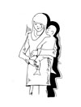
What do we mean when we say SGBV?
Sexual violence is a form of gender-based violence and encompasses any sexual act, attempt to obtain a sexual act, unwanted sexual comments or advances, or acts to traffic, or otherwise directed against a person’s sexuality using coercion, by any person regardless of their relationship to the victim, in any setting. Sexual violence takes multiple forms and includes rape, sexual abuse, forced pregnancy, forced sterilization, forced abortion, forced prostitution, trafficking, sexual enslavement, forced circumcision, castration and forced nudity.
https://www.ohchr.org/sites/default/files/Documents/Issues/Women/WRGS/OnePagers/Sexual_and_gender-based_violence.pdf
Notes:
Invite participant to add to this list if they have other suggestions.

Slide 4
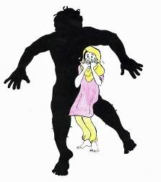
Key findings from our research over
30 years in 22 countries
Sexual and Gender Based Violence (SGBV) is a/the major barrier to Gender Equality.
Meaningful participation for women and girls is not possible without gender equality.
Gender equality is not possible unless we acknowledge and address SGBV.
Notes:
Sadly despite the fact that SGBV is endemic in all refugee sites, it is seldom discussed, except as a ‘women’s issue’ and the important links between SGBV and all aspects of women’s lives is not acknowledged or addressed.
See Background readings for discussion points if needed

Slide 5
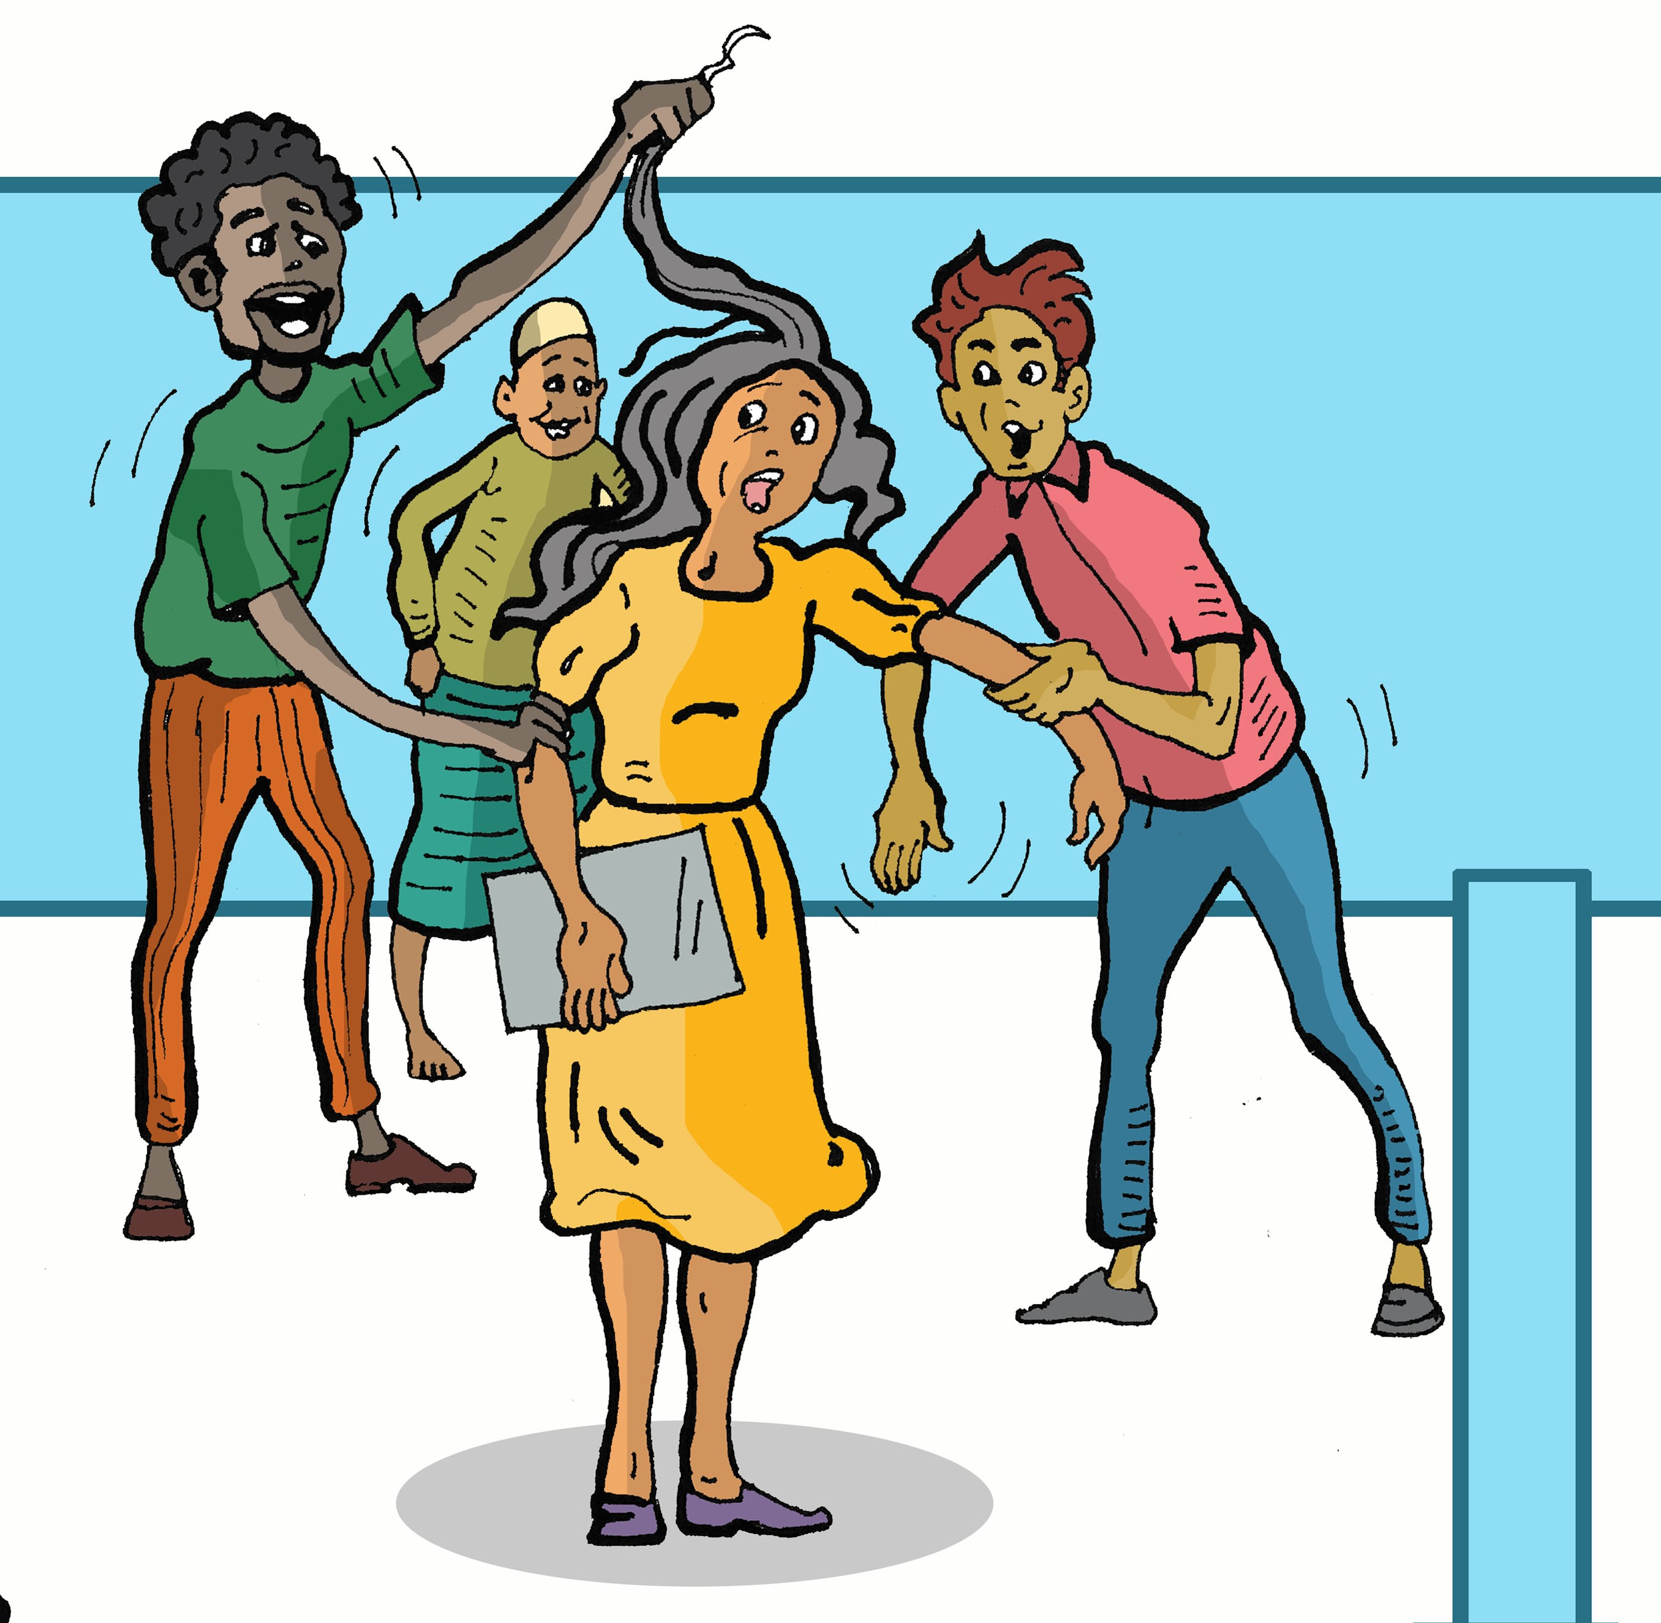
The difference between refugee women and women in host countries.
It has been argued that, while tragic, the experience of refugee women and girls is often no different to the women in the host countries to which they have fled.
There is of course one major difference. Refugee women are citizens of no-where. They do not have even the minimal protection that this can offer. They are placed into situations of extreme vulnerability Many men are killed or away from their families. Women are raped to shame or punish the men in their families and communities.
Notes:
Ask participants to suggest other differences between refugee women and women in host communities.

Slide 6
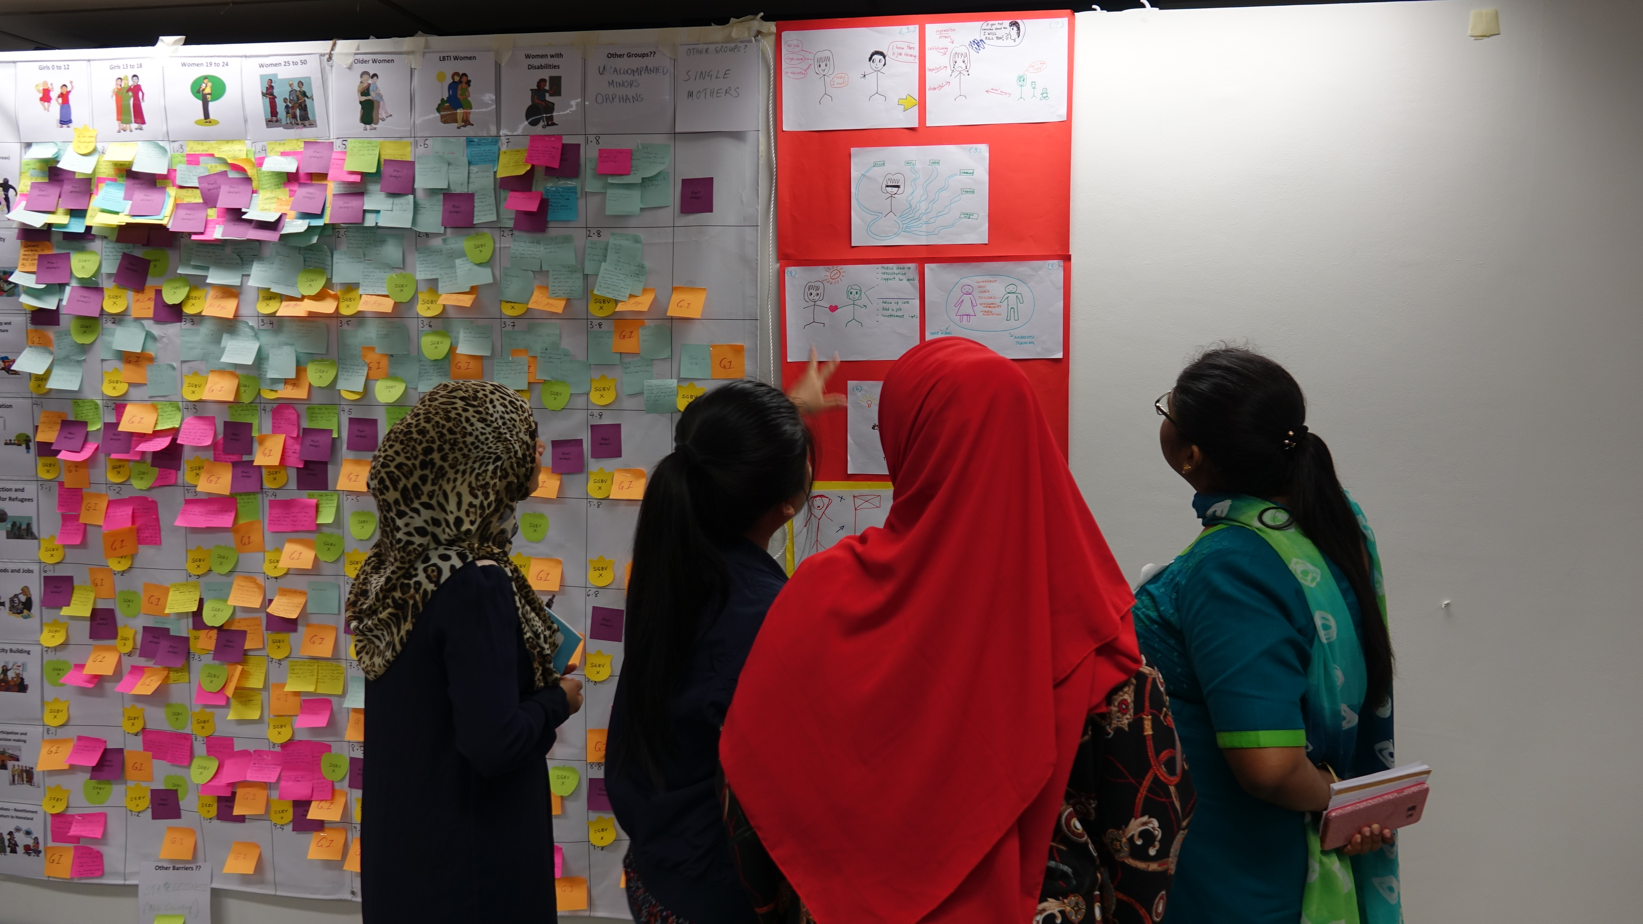
Evidence
Refugee women and girls face SGBV in all areas of their lives.
In 2018, using the Matrix Tool, we conducted consultations with over 400 refugees and 100 local stakeholders, in Thailand, Malaysia and Bangladesh, examining barriers to gender equality in a number of key thematic areas.
Notes:
Go to next slide

Slide 7
SGBV was identified as a major concern in all of the areas indicated below
SGBV
SGBV
SGBV
SGBV
SGBV
SGBV
SGBV
SGBV
SGBV
SGBV
SGBV
SGBV
SGBV
SGBV
SGBV
SGBV
SGBV
SGBV
SGBV
SGBV
SGBV
SGBV
SGBV
SGBV
SGBV
SGBV
SGBV
SGBV
SGBV
SGBV
SGBV
SGBV
SGBV
SGBV
SGBV
SGBV
SGBV
Notes:
SGBV was discussed as a major barrier by each group in each issue discussed.
This has to be addressed in each of the areas not just as a health issue.

Slide 8
“Before the GCR, Refugee women were constantly being “mainstreamed” into oblivion” They still are!
SGBV changed to GBV, most commonly used in the refugee context to mean domestic and family violence. The scope of abuse experienced by refugee women was diminished and not addressed.
GBV and AGD have become meaningless acronyms, easy ‘tick boxes”
There is a constant battle to stop SGBV being sidelined, and ignored.
Notes:
If time allows, ask participants to discuss why they think this happens.

Slide 9
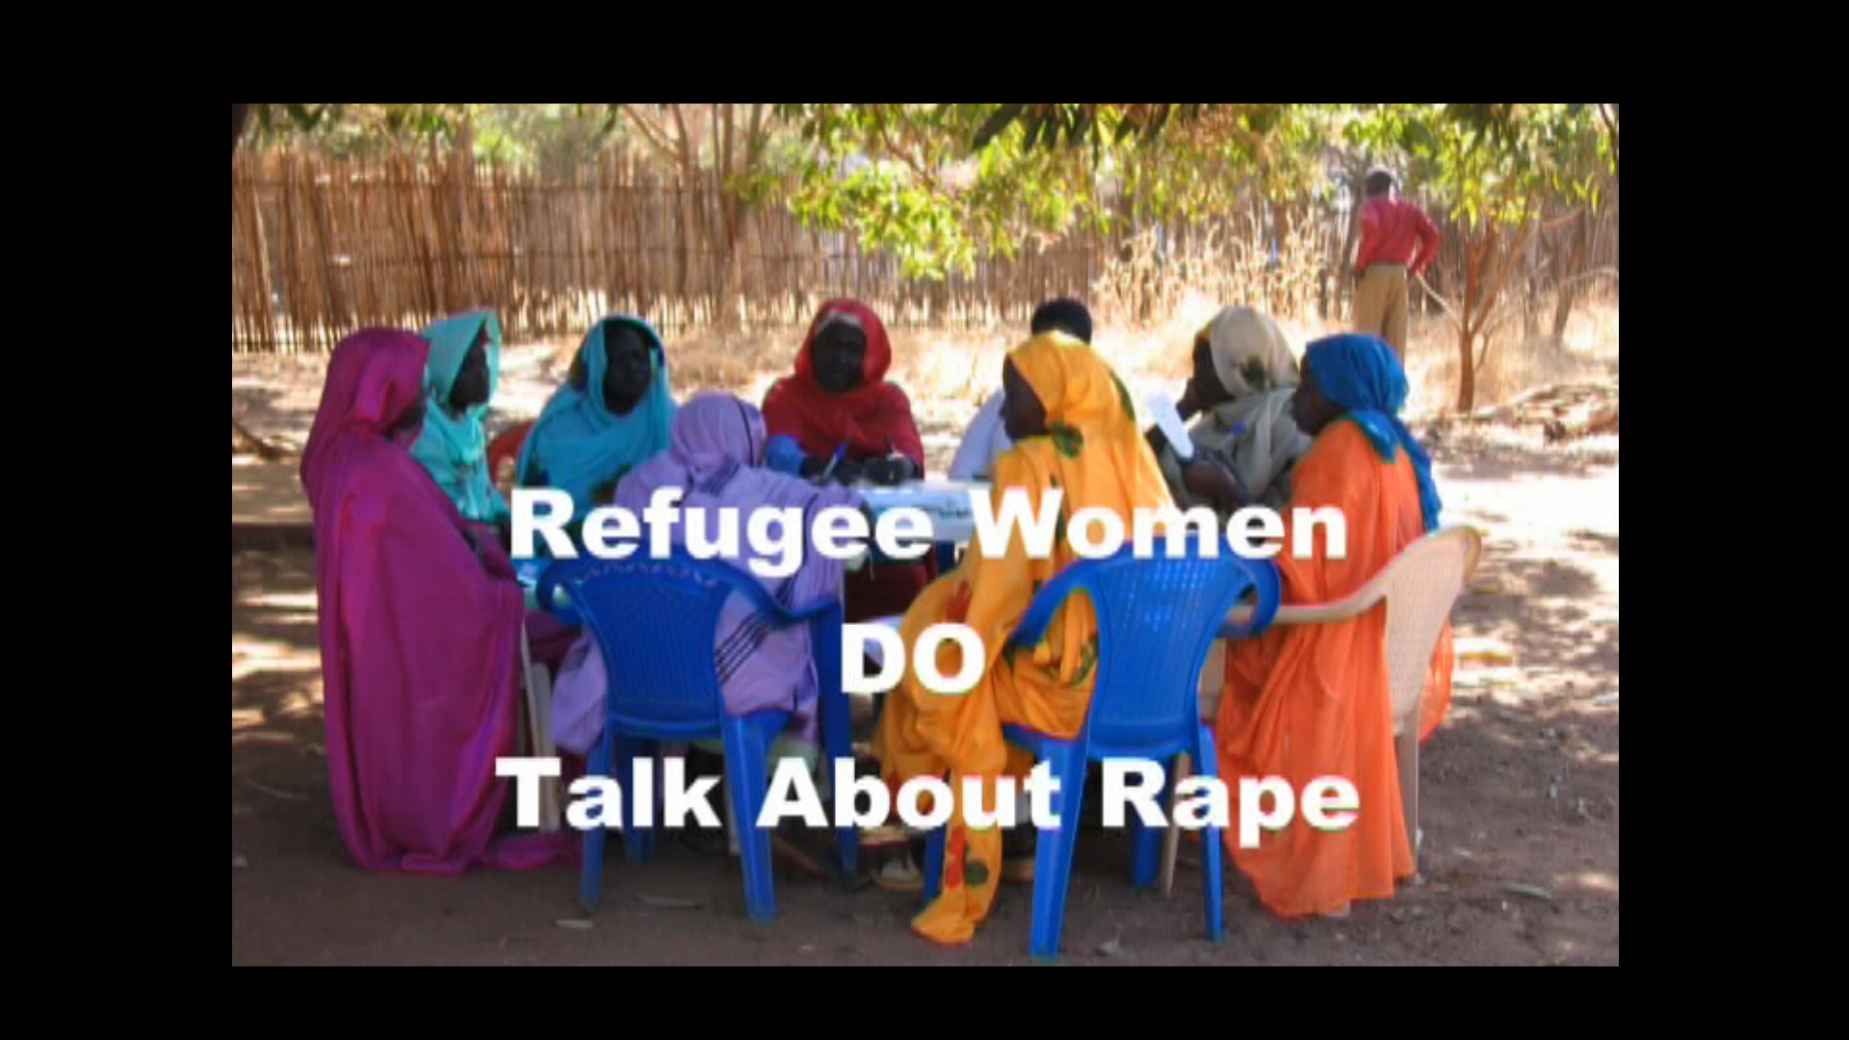
Women won’t talk about Rape -Short video
Over the years, we were constantly told we were mistaken – that women would not and did not talk about rape
At one UN meeting, in desperation, our film maker threw together a short film, which we were allowed to loop as governments came into the chamber.
This is the result. Grown men cried!
Notes:
People are often very shocked, or in tears after watching this video. Give time for silent contemplation, or for people to talk if they want to.

Slide 10
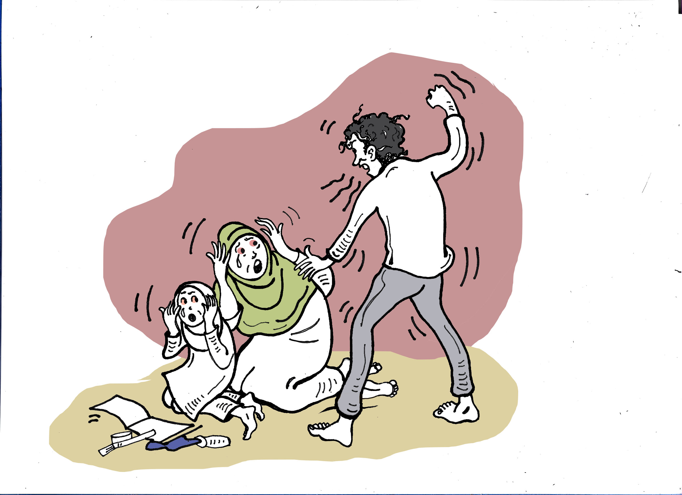
Root causes & Contributing factors to the barriers caused by SGBV
Privileging male leadership in refugee camps and urban settings
Decreased International Aid contributes to food, water and fuel insecurity and increased risks of SGBV including rape, abduction, trafficking, forced and early marriage
The lack of appropriate SRH services including lack of sanitary materials also contributes to high rates of maternal and infant deaths, HIV, and illegal abortions, especially for young women and adolescent girls
In 2023, Only 0·01% of humanitarian funding was for gender-based violence prevention and response programmes, 2/3s of GBV programmes in humanitarian appeals received no funding at all
Notes:
Discuss the implications of these barriers, and ask participants if they have others.

Slide 11
Some major response barriers
The lack of standardisation and recording including lack of AGD disaggregated date
The scale of SGBV is underreported due to many barriers to disclosure including stigma, shame, lack of understanding of SGBV
Policies addressing SGBV often fail to consider factors associated with forced migration e.g. fear of authorities, fear regarding immigration status, of self or family members being deported/left behind,
Current SGBV services in all sites do not offer clearly defined referral pathways
(Hourani et al 2021; Phillimore, Block, et al (2022);Izugbara et al. 2020)
Notes:
As above

Slide 12
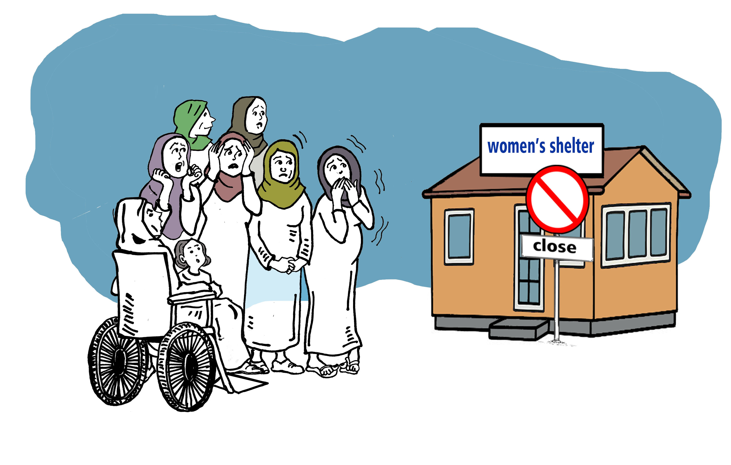
- continued
Lack of context and culturally appropriate SGBV services developed in partnership with refugee women and girls
Funding is limited and not available to local organizations addressing SGBV (IRC 2019)
Gender sensitive mental health and psychosocial support services remain sparse in all settings.
Women and girl safe spaces play an important role in camps but there are not enough
Limited employment and educational pathways despite the evidence they play a key role in protection
Notes:
Can participants add others?

Slide 13
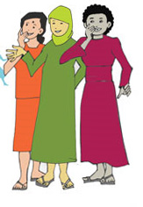
Adolescent Girls
Child marriage, domestic violence, and sexual violence are the most prevalent forms of gender-based violence against adolescent girls – often leading to early pregnancy and death in childbirth
There is no clear division of labour between actors from the SGBV and child protection sector. adolescent girls, in particular older girls, are often overlooked in both sectors.
SGBV in displacement settings is one of the least funded areas of humanitarian response.
(Stark, L., I. Seff and C. Reis 2021)
Notes:
We often talk about SGBV in regard to refugee women, but research has clearly shown that girls from puberty onwards, and sometimes even younger are victims of severe sexual and gender based violence.

Slide 14
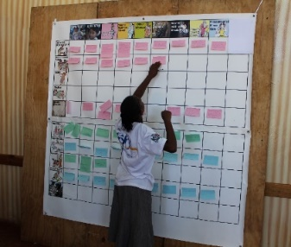
Using the AGD Matrix Exercise to identify problems and barriers
The matrix can be used to gather evidence about a number of issues in one sitting, which can take a full day, or you can tailor it to what you are particularly exploring in a session.
We have found it an excellent exercise to gather information about how SGBV affects diverse groups.
Notes:
Please see Reciprocal Research in Additional Resources for full details of using the Matrix exercise

Slide 15
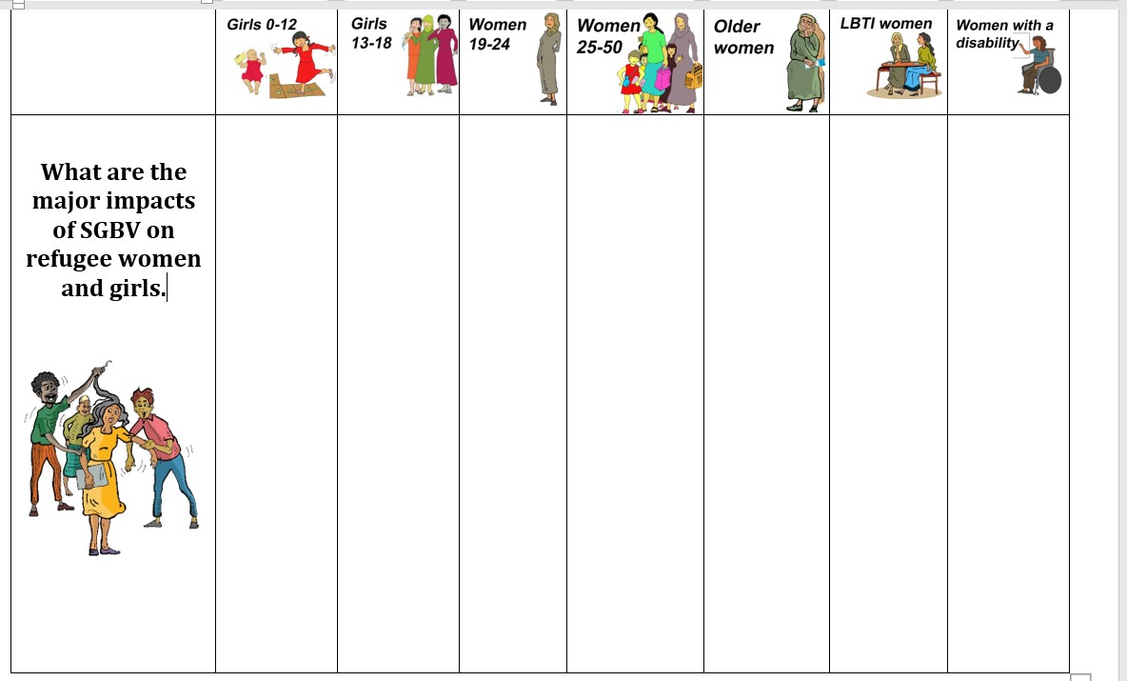
List how SGBV affects each diverse group on the top of the Matrix
Notes:
Ask participants to complete the exercise in small groups and feed back to the large group
Pull the results together by discussing the different ways in which the groups are affected, and that this will require a range of effective responses.
Now move on to Storyboarding to develop solutions.

Slide 16
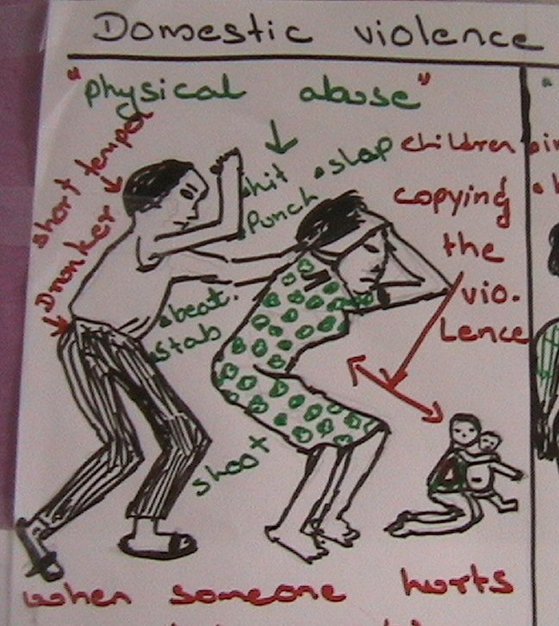
Storyboarding
Storyboarding moves from problem identification to problem solving. It is an excellent way to engage members of refugee communities in identifying appropriate local solutions.
Notes:
This technique has been used with people who are preliterate, women and men, people with tertiary education and a huge diversity of backgrounds.
If people are reluctant because they think it is childish to draw, remind them that there is a saying in English, ‘A picture tells a thousand words’ and ask if they have a similar saying in their languages.
Once they start doing it, people quickly see the value of the exercise.

Slide 17
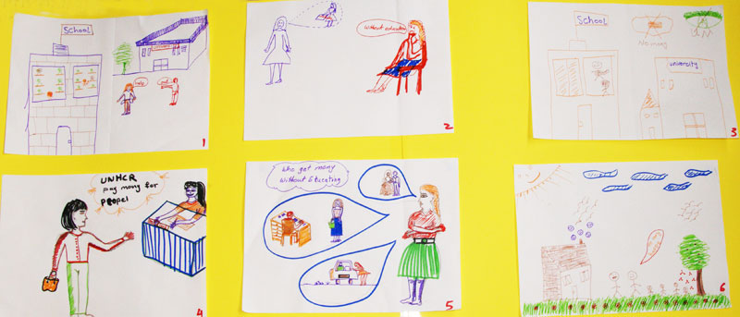
Participants use storyboards to
identify problems and suggest solutions
  What is a story board?
  How story boards can be used to solve problems with refugee communities
  Preparing story boards
Notes:
Note to Facilitators
Story Boards analyse problems and suggest solutions
They help people move from story telling to problem solving and goal-setting
They will provide the basis to the response to problems articulated in the story circles
When the participants present their Story Boards they will be expected to fully discuss what is happening in each picture and the discussion they had about the issue in their groups. Explain that the facilitators will be asking questions at the end of each presentation to get as much information from the women as possible
The storyboards will be used in reports and advocacy work with service providers
Materials Needed
Each Group will need several large sheets of coloured cardboard, and flip chart paper, coloured paper, big coloured marker pens (thin pens do not make good presentations), scissors, glue, sticky tape – anything you can make for making good poster presentations, and plain A4 paper for each stage of the storyboard.

Slide 18
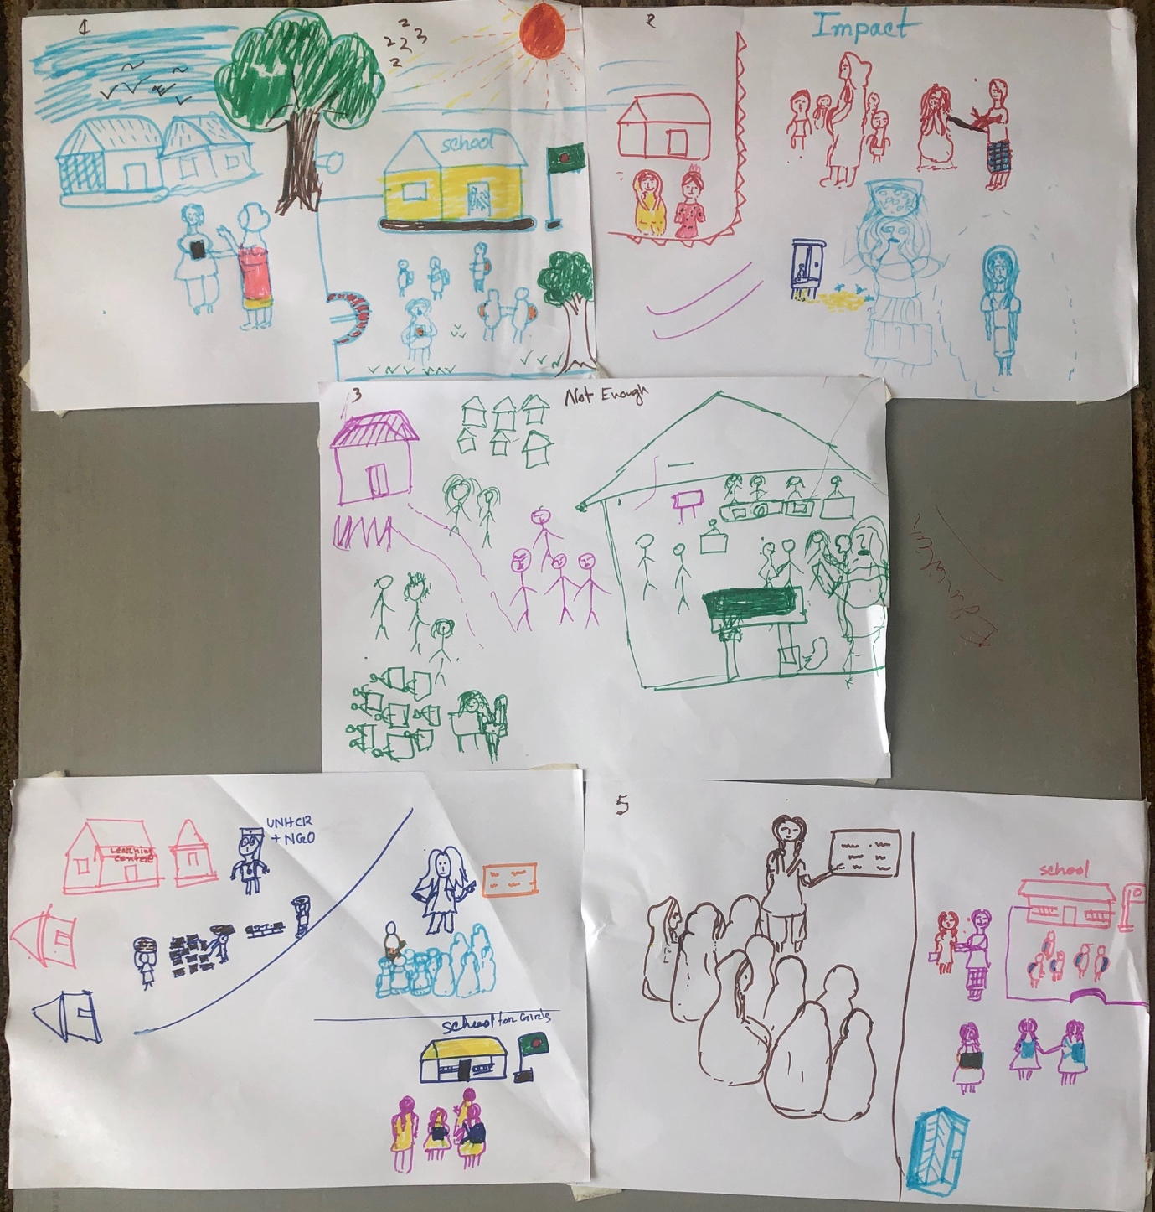
How does it work?
Notes:
In small groups, participants are asked to draw a series of six pictures, answering 6 questions, which start with a depiction of a problem, then the impacts of the problem on individuals, families and communities. Next they are asked to show what assistance is currently available for the problem, then the ‘magic’ question They are asked to draw how they would address the problem, if they were in charge of services. Next comes who they think could help them achieve this, and what support they would need to do it, and lastly, what would be the results of their ideas being implemented.
It is important to decide before the exercise begins what the questions are. This can be done either by the facilitator or with the participants.
It is suggested that the facilitator sets the task and asks the groups to work out what they want to depict and how they will do this before the drawing materials are distributed. This avoids one person taking the materials and drawing before group discussion about the messages they want to give.

Slide 19
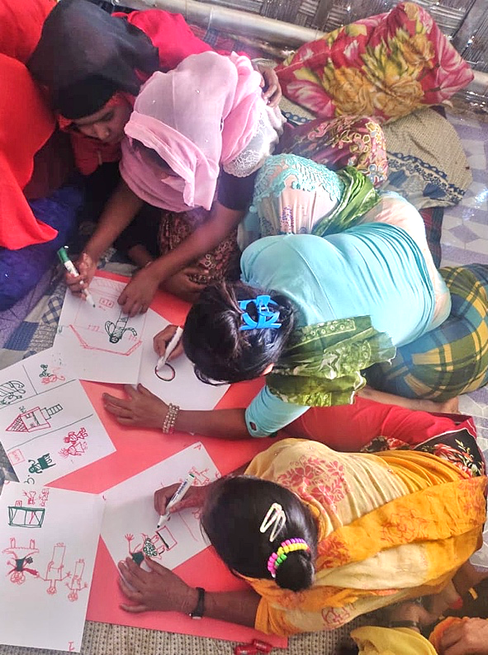
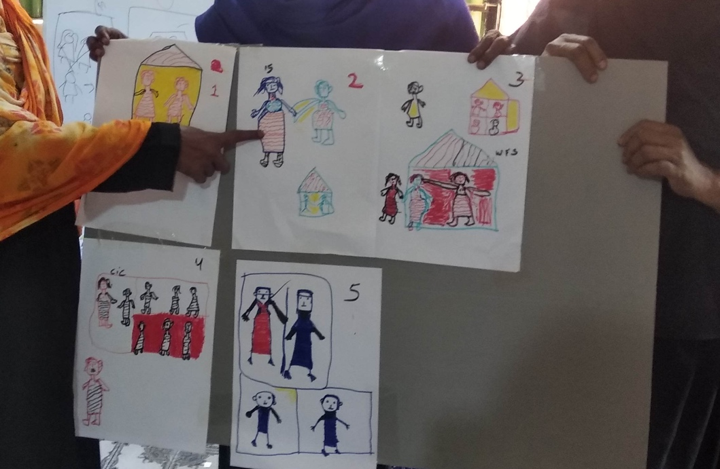
From Problem Identification to Solutions.
The Storyboard Tool
Participants draw and present their responses to questions about a problem facing their community, what is available to respond to this problem, their ideas for other solutions, and what role the community, NGOs or other groups could take in these solutions.
The verbal presentations are documented and form core research data.
Notes:
It can take 15 -20minutes to discuss a story board properly, so keep this in mind when deciding on the number of small groups can be used in the time available.

Slide 20
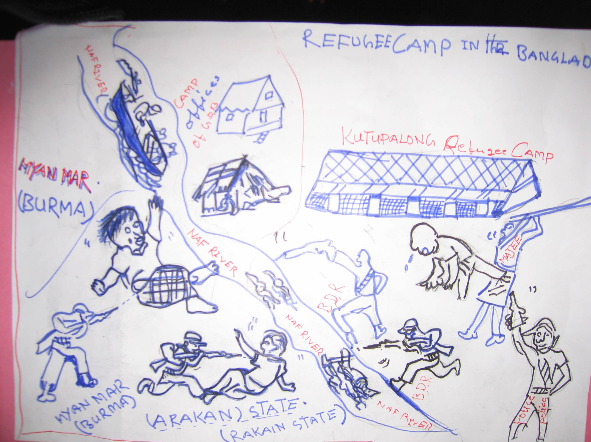
Storyboarding questions could cover:
Depict a problem of concern experienced by people in your community. (An example might be the lack of education for women and girls)
How does it affect the people concerned, what happens to them, how does this affect their families, their communities?
What happens to these women and girls now? (What help is available to them and is it effective?)
Notes:
Depending on the topic, and aims of the session, these can either be set by the facilitator or developed with the group.

Slide 21
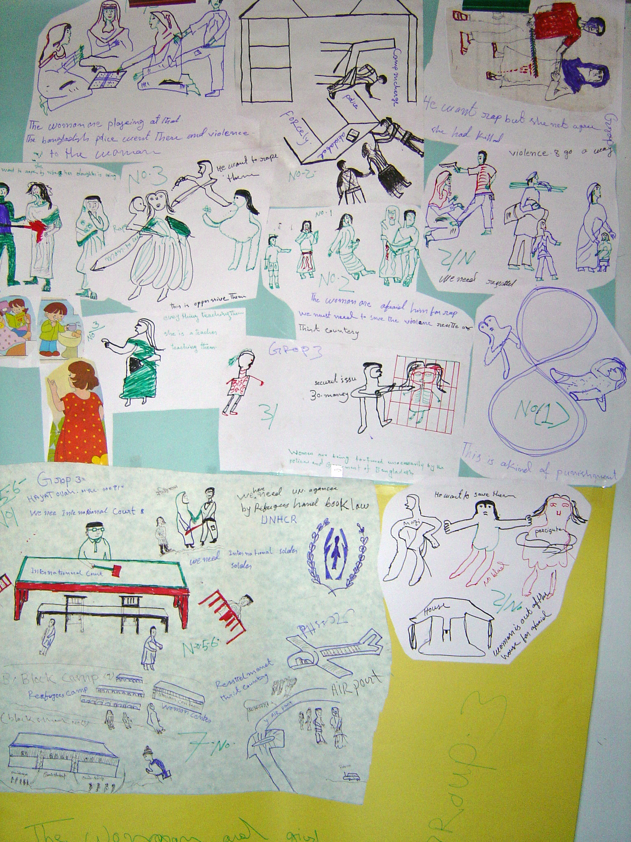
Storyboarding questions continued:
4. If you were in charge of services for this group of people, what would you provide for them, their families and the community, to address this issue?
5. Who else do you think could provide these services, Who would you want to do this, What help would WRLOs need to address it?
6. If all these services were available what would be the best outcome for these participants?
Notes:
As above.

Slide 22
Documenting the discussion of the drawings
Participants need to be given enough time to fully explain and discuss what they have drawn.
With the permission of participants, this must all be carefully documented and becomes evidence for future actions.
Notes:
A good facilitator will ask questions about the drawings, and what they are saying to draw out details.

Slide 23
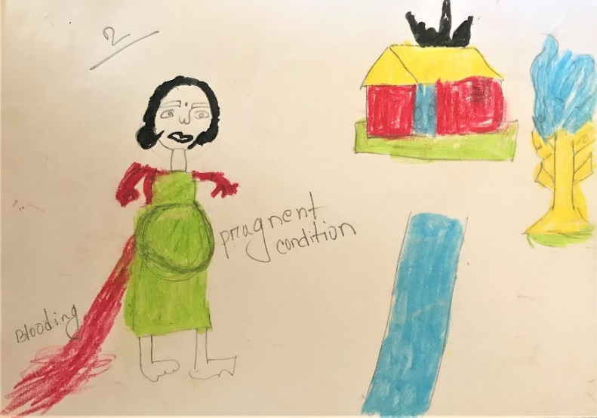
Some examples
A 12 years – old girl is married to a 40 years-old man…. She got pregnant shortly after the wedding. Being pregnant is not good for her health. This time her physical condition is not well. A lot of bleeding from her body. The women facing some problem such as [early pregnancy], they will be physically un-well, they will die, baby will be die when delivery time (Refugee women Camp 18).
Notes:
The facilitator could explore why the girl was married early, how often this happens in the place where they are, how the women feel when this happens, and how the young girls respond to being forced into early marriage? If they survive, how does the girl cope with being a child mother?

Slide 24
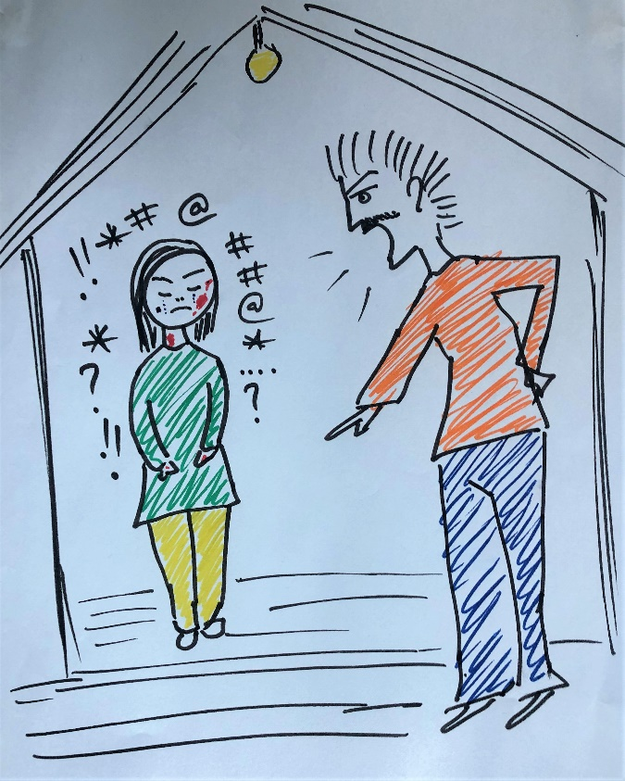
You don’t even need the dialogue!
The topic was abuse including rape by an employer
Refugee Group, Kuala Lumpur 2018
Notes:
Many of the drawings are very explicit. You could ask what the employer is threatening her with, and why it is important she keeps the job.

Slide 25
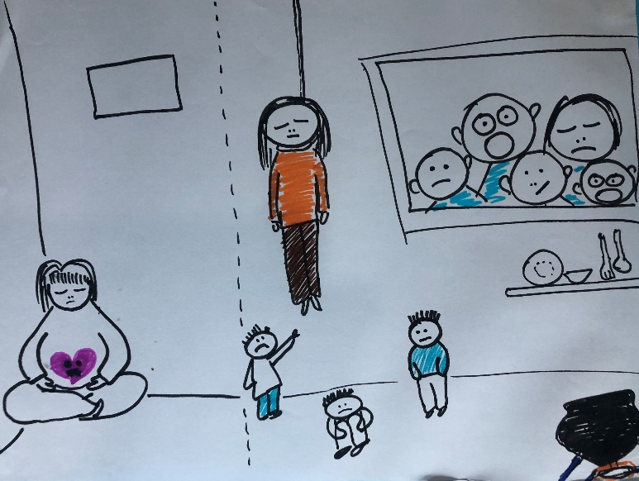
Her response when she finds herself pregnant and the impact on her family
Notes:
Suicide is often reported by women’s groups in situations such as this. Ask how this affects the various members of the family, women leaders and community members.

Slide 26
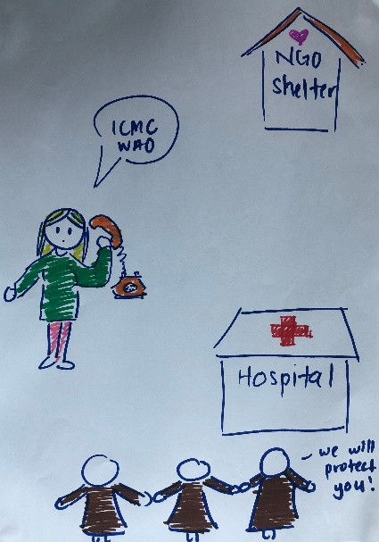
The help the women wanted, but could not always access.
Notes:
How do the women feel when they cannot get help for women in cases like this? Be prepared to hear some angry or ‘defeated’ responses and acknowledge that it is not their fault.

Slide 27
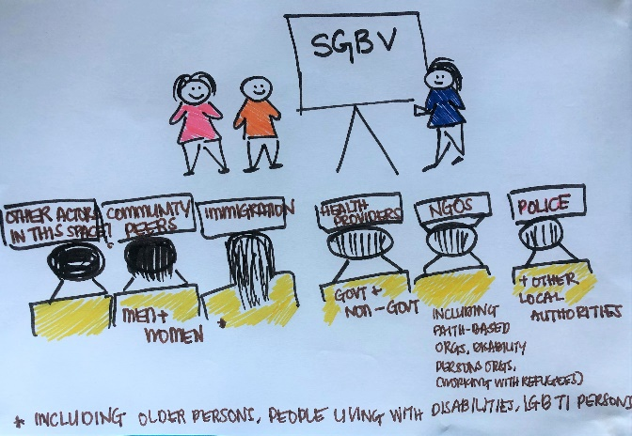
How to achieve change
Notes:
What are their suggests for improved responses and service provision? Help them unpack exactly what it is they want, and what is realistic where they are living.

Slide 28
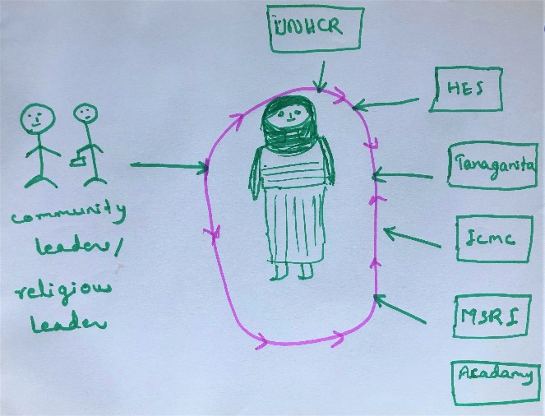
Comprehensive Protection and Care
Notes:
As what each of the organisations mentioned could do to provide this circle of protection for the woman.

Slide 29
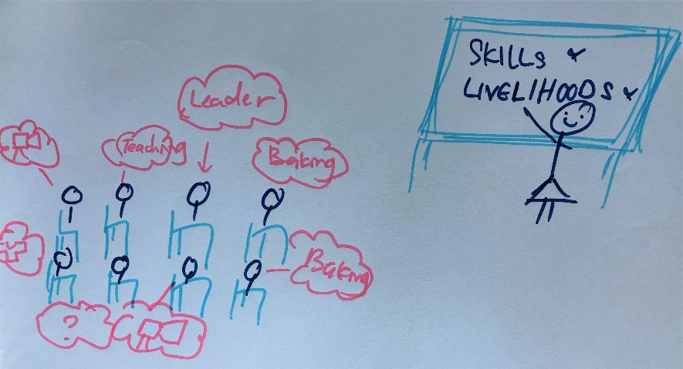
Moving forward – addressing the links between Livelihoods and addressing SGBV
Notes:
The last drawing is not just a ‘happy ending’ Ask the women to make clear links between what they suggest and the root of the problem, for example a lack of safe livelihoods and rape by employers. How will their solutions address this?

Slide 30
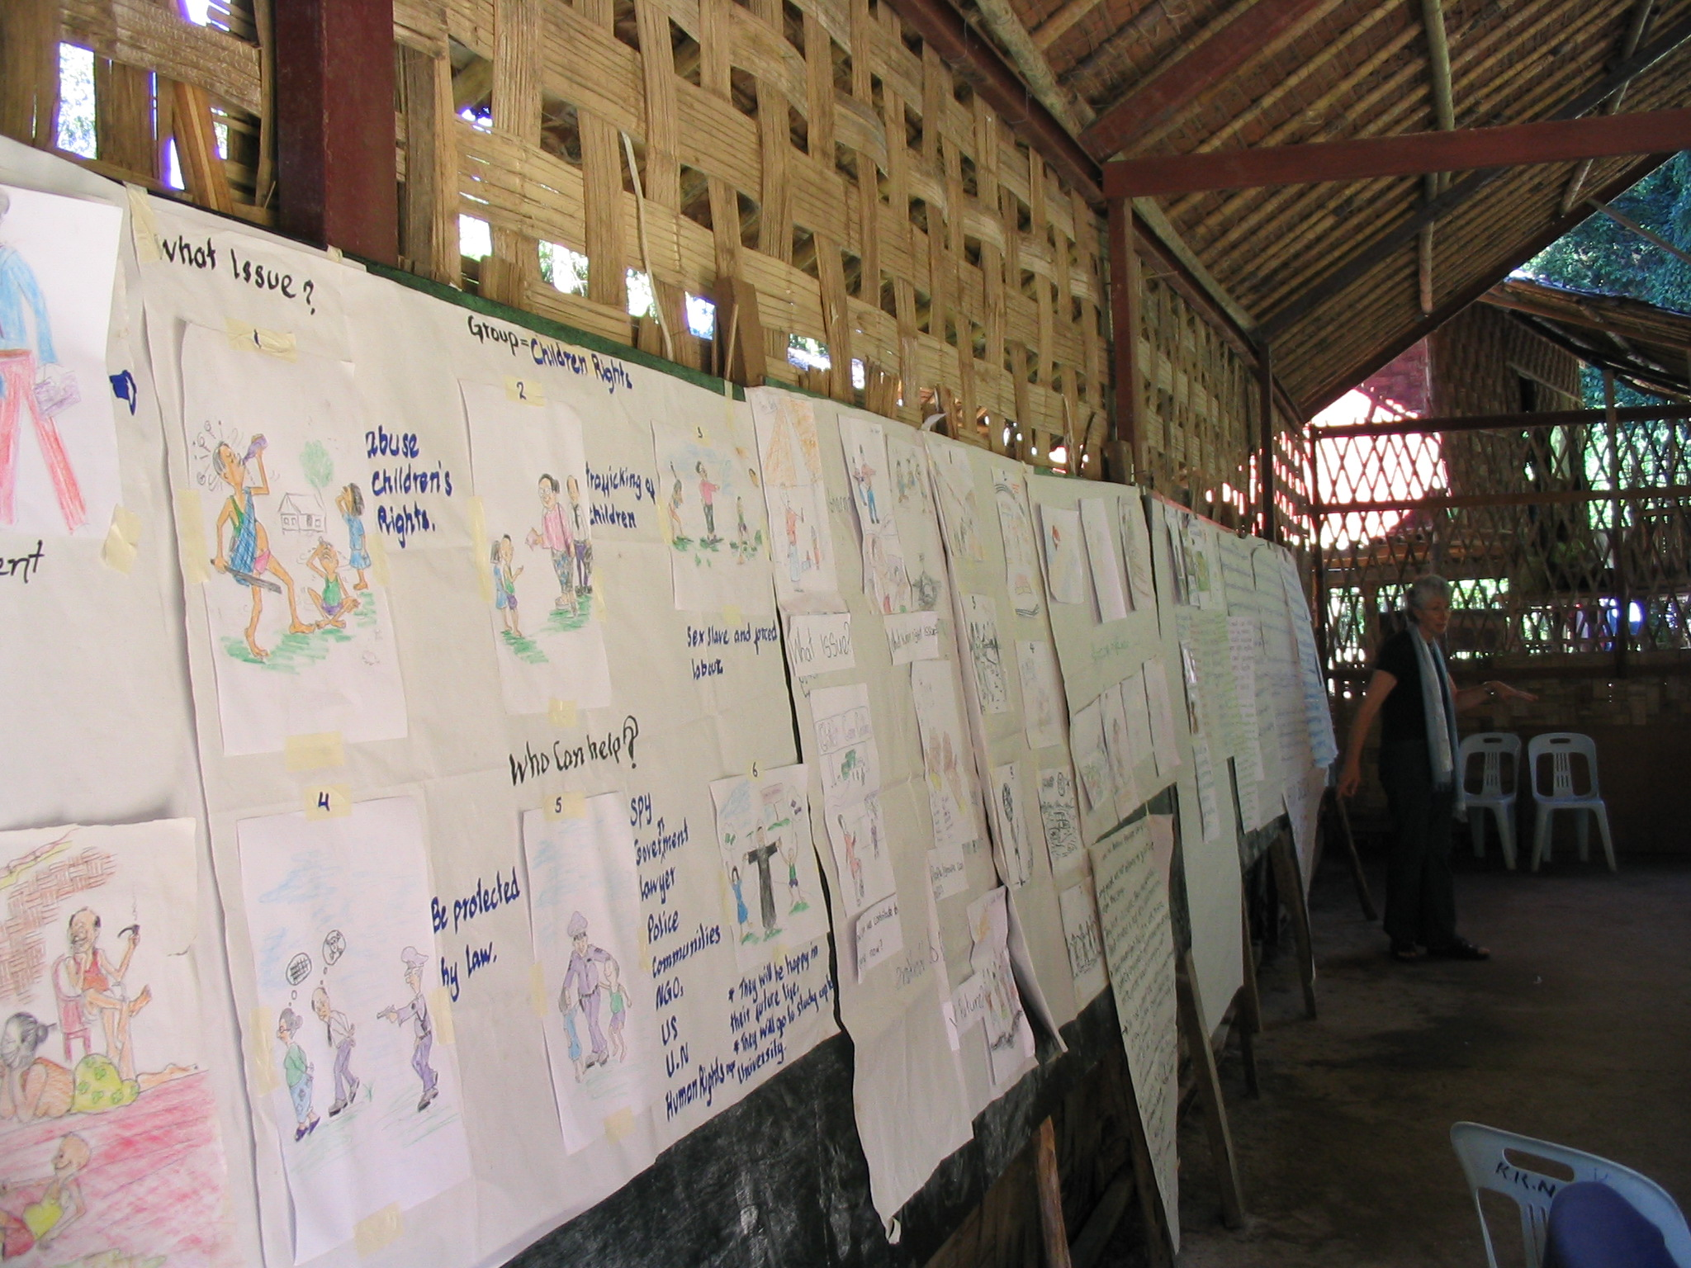
Using the data collected
The outcomes of the story boards will form the basis of the next stage of the risk analysis and response.
Notes:
It is essential that the discussion about the story boards is recorded verbatim by the facilitators.
Take photographs of the story boards , and each of the six drawings to match with the narrative documented for the final report.
Make sure participants approve the reports before they are used for advocacy. This can be set up at the time of the consultations, and spokes persons appointed who will receive the reports and ensure the women approve what you have included, and any photos you may be using.

Slide 31
How to use the evidence
Combine and classify the data collected, and take it forward into strategic planning, to inform new programs and approaches.
Notes:
You can use this information as a basis for Strategic Planning, Module 14

