Slide 1

Session 12:
Using an Intersectional Approach to Develop a
Strategic Plan
Notes:
REMEMBER:
Data collected from the tools and exercises presented in this resource kit are evidence which can be used to work with communities in many ways.
In this session we explore ways of doing this.

Slide 2
Using the Data
The aim of the session is to assist Refugee Led Organisations, their partners and other stakeholders to make realistic assessments of what can be achieved at a given time, in a particular site, to develop effective and achievable strategic plans which support meaningful participation, address SGBV, and identify issues which need further advocacy work
Notes:
This is a working session.
Ask the participants to work in small groups to identify a number of actions they would like to take to follow up on the training.
Once this has been fed back to the large group, devise an agreed list and ask the participants to prioritise the issues.
Note to Facilitators
In the excitement of the sessions, do not promise to do anything which you cannot guarantee to deliver!!
Be honest about your limitations, and the limitations of the system within which we work.
Encourage participants to take responsibility for some of the actions.

Slide 3
How can the information shared in the exercises and tools be used?
To address issues discussed in the consultations
To write reports for advocacy
To inform policy
To improve services
To validate and celebrate the lives of
the community members
As an historical record
To develop a strategic plan of action with other stakeholders
Notes:
Brainstorm potential uses of the data with participants.
They may have innovative ideas about the use of the data and how best to present it to different audiences.

Slide 4

So what is Strategic Planning?
Strategic planning is a process in which key stakeholders define their vision for the future and identify their goals and objectives. The process includes establishing the sequence in which those goals should be realized so the organization or group of partners can reach its stated vision.
Notes:
If appropriate , work with the community to develop a plan of action including:
Timelines
Activities
Resources needed
Support needed
Issues to be addressed
Actions to be taken
Planned outcomes
Persons who will take on the tasks
People to be approached for assistance
How will they evaluate the outcomes
Arrange for this to be typed up and distributed to the participants and ensure that someone will be working with the community to follow up on what has been decided.

Slide 5
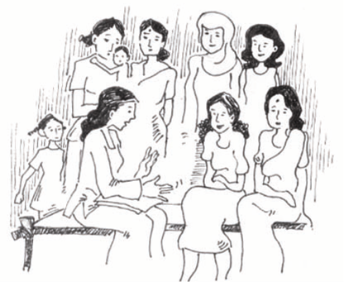
It is a Partnership Task
We need to:
Work with the community to design a plan to take their concerns and suggestions forward.
Use the data collected to inform this.
MOST IMPORTANT OF ALL
Record the skills, experience, capacity and capability of the participants and the communities.
Make recommendations with the participants which build on these.
Encourage the participants to appoint a group to follow up on the agreed actions
Notes:
Build on the work done in the module addressing effective partnerships.

Slide 6
The major parts of a standard strategic plan include the following:
Mission, vision, and aspirations.
Core values and principles
Objectives, strategies, and implementation plans
Measurements and funding streams.
Notes:
Build on the work completed in the module on Program design available in additional Resources if you have also used that Module.

Slide 7
Steps to be taken–
Analyse the data/evidence from all of the tools and exercises
Collate all of the key points from feedback.
Note the key lessons can be learned from the work
Identify emerging trends - are participants saying similar things?
What does it tell you about things which need to be done?
What strengths and capabilities have been identified and can be used?
Notes:
If time permits, go through this exercise with the participants, either as a brainstorm, or in small groups, with large group feedback, or make time to do it in future sessions.

Slide 8
The aim is to bring together the data from all of the areas we have covered in the training modules, and examine how this might assist us in effective program planning with Refugee Led Organisations
This template for strategic planning can be used to identify local conditions and contexts, to help decide which model of participation is most likely to succeed at this time and in this site, and what can be done to move things forward.
Below you will find a case study to work on as an exercise.
Notes:
If you have a more appropriate local case study, or actual situation, use that instead.

Slide 9
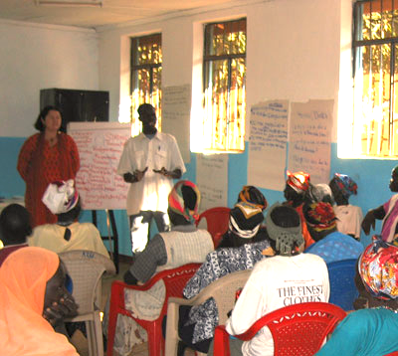
Case study
The local authorities and the legal system in the host country are hostile towards refugees. The refugees live in an enclosed camp, although some do work informally in the local economy. They are not allowed to have bank accounts, and no work rights.
Many women have never had the opportunity to go to school. They are mainly excluded from meetings between the leaders UN agencies and camp authorities.
The camp is a dangerous place, women are afraid to travel alone, bathrooms are unsafe. Local men, authority figures and family and community members all pose risks to the women and girls.
At the moment, only refugees who speak English and who are literate are invited to meetings.

Slide 10
Case Study Continued
5. Many male refugees are very traditional in their cultural mindset, and also very protective of their wives, daughters and other female family members because of the high rates of SGBV.
6. INGOs and UN agencies do not work collaboratively, in part because there is competition for scarce funding.
7.The whole site is very hierarchical, with those with most privilege having all of the power. Local NGOs are afraid they will lose their jobs if RLOs take over service provision.
8.Senior staff change frequently and donors usually only commit to short term funding, so there has been little movement towards a Development model. While A Human Rights approach is often ticked on forms there is little evidence that it is implemented.

Slide 11
Issues to be addressed
What are the key structural issues which will impact on meaningful participation in this site?
What are the gender-related social issues which will impact on meaningful participation in this site?
What measures need to be taken to address SGBV in this site?
How do we ensure that the lived experience of grass roots refugees, including women is taken into account?
How can we include refugee men in this site?
Who can we make effective partnerships with?
What can we do to moderate the power of privilege in this site?
What steps do we need to take to ensure that the projects and programs we develop/fund the move from humanitarian to using a Human Rights Based Development approach?
What type of Participation is currently possible in the site?
Notes:
Remind participants that they should go back to the work they have completed in previous sessions.

Slide 12
Key Questions
What can be done to address or accommodate these in the short term?
What can be done to address or accommodate these in the longer term?
Notes:
Encourage participants to answer these question in light of the current structural constraints, and then how this could possibly change in the future.

Slide 13
When this exercise is completed, draw up a strategic plan to shape future actions.
Develop a communal vision with all partners and stakeholders
Decide what you want to achieve. What will be the outcomes of your projects?
Describe the projects. What exactly do you want to do?
Identify potential funders – Who might be interested in these projects?
Notes:
This is a big exercise, and if time allows should be allocated a full day at least. It will need time for research into possible activities, resources available, and potential donors, partners and supporters.

Slide 14
Ensure your projects meet the criteria and philosophy of the funders you are targeting.
Consider the principals involved, i.e. AGD, HR approaches, addressing SGBV.
State key values, e.g. gender equality, accountability, accessibility.
Develop focus areas. Break the task down into achievable chunks.
Create specific objectives. -what do you want to achieve in each section of the project?
Define key performance indicators – What is your evaluation strategy?

Slide 15
Good Luck with your work!

