Slide 1
‘Intersectionality’ and ‘Age, Gender and Diversity’

Slide 2
Part 1: Introduction to an age, gender and diversity and
Intersectionality approach [UNHCR and UNSW]

Slide 3
What is ‘intersectionality’?
Intersectionality refers to the ways in which the different aspects of a person’s identity, what we will call layers, affect the way they are viewed by others and thus affects their life.
Originally it was used to describe the impact of multiple oppressions experienced by black women in the US.
It recognises that forms of oppression such as racism and sexism do not operate independently but intersect, compounding the impacts of each.

Slide 4
Intersectional strengths and vulnerabilities
Intersectionality recognises that intersecting and overlapping identities can be both oppressive and empowering.
Intersectionality creates both strengths and vulnerabilities in individuals.
Some of our identities help us to be resilient and productive members of our communities, but others lead to discrimination, marginalisation and oppression.

Slide 5
Example 1: The many layers of a refugee girl with a disability

Slide 6
Example 2: The many laters of an an elderly stateless refugee

Slide 7
Group discussion/brainstorm
Reflect on some of your own identity labels and discuss which provide strength and which create vulnerabilities.

Slide 8
What is ‘AGD’?
The Age, Gender and Diversity approach, or ‘AGD approach’ as it is usually called, is the cornerstone of UNHCR AGD Policy.
It recognises that like the rest of the world, people who are refugees, forcibly displaced and/or stateless, are very diverse.
They include people of all ages, genders, nationalities, religions, disability status, sexual orientation and gender identities, as well as national, ethnic, religious, linguistic minorities and indigenous peoples.

Slide 9
AGD Policy
The AGD Policy is designed to ensure that all diverse groups are treated equally. It commits to:
Inclusive programming to ensure that no one is left out
Providing opportunities for all refugees, forcibly displaced and stateless people to participate in decision making about their own lives
Providing women and girls equal access to documentation, and control over food and relief items and cash
Providing equal access to economic opportunities, work, education and health services.
Providing comprehensive prevention, response and risk mitigation services to address gender-based violence, including sexual violence.

Slide 10
Part 2: How intersectionality and the age, gender and diversity
Approach relate [UNHCR and UNSW]

Slide 11
How do intersectionality and AGD relate to one another?
Understanding intersectionality helps us to apply the AGD policy in a meaningful way.
It ensures that we are not only seeing the various aspects of a refugee’s identity, but the way they work together to create unique challenges and strengths.

Slide 12
Intersectionality as a ‘road map’

Slide 13
Group discussion/brainstorm
Think of a particularly vulnerable refugee or forcibly displaced individual you have worked with.
If you were to make a ‘road map’ of the multiple discriminations they may be experiencing, what ‘street names’ would you include?
In your analysis consider: gender, race, ethnicity, religion, age, ability, socioeconomic status, legal status, sexuality.
What are the impacts of this intersectional discrimination on the individual?

Slide 14
Part 3: Intersectionality and the power of identity layers and labels
[UNHCR and UNSW]

Slide 15
Celebrating our layers
Layers are a positive aspect of our identities.
We all have many layers, they make us the interesting and diverse people we are.
Most people do not see all of our layers.
Their perception of us is formed by just what they see, and how they feel about that layer.
Problems can occur when some of the layers are turned into negative labels which people put onto us.
This woman could have all of these layers. We must respect each one of them.

Slide 16
The power of identity labels

Slide 17
The power of negative identity labels

Slide 18
The power of positive identity labels

Slide 19
We must work with all of the labels

Slide 20
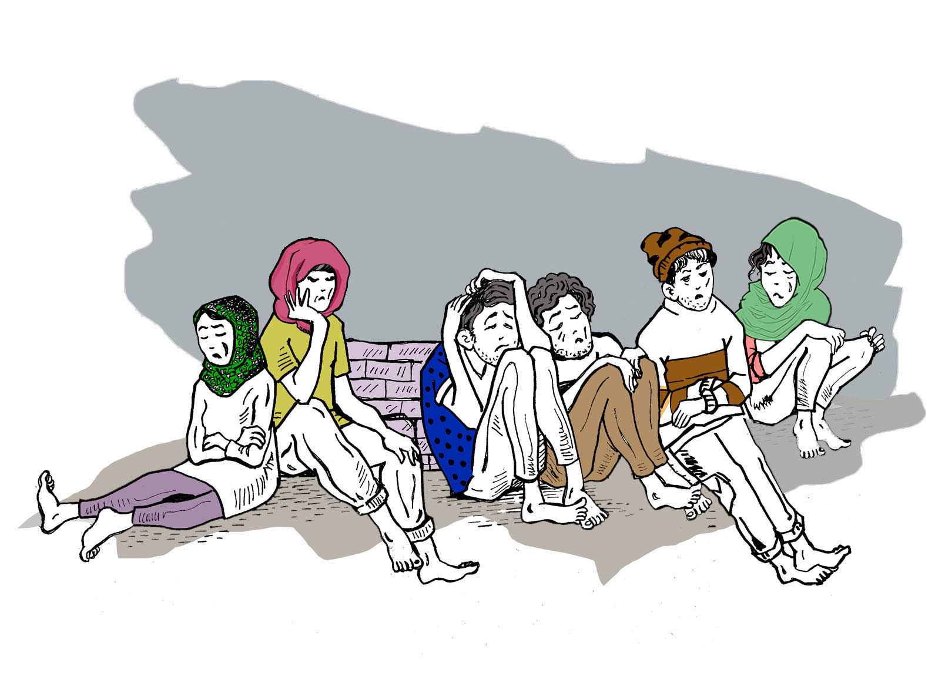
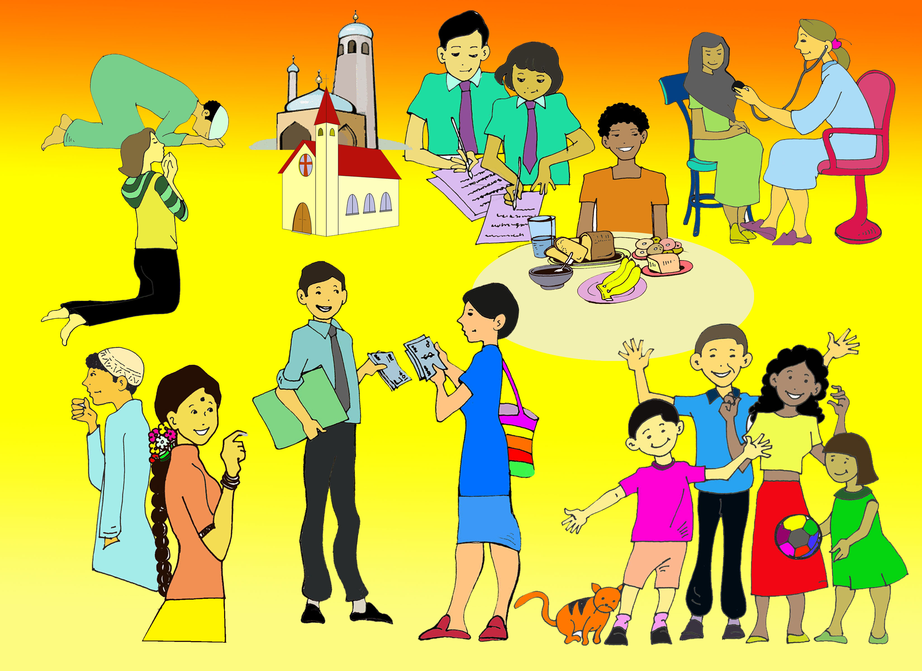
Group discussion/brainstorm
Use the outline of a woman either on a flip chart or an additional slide and fill it in as participants respond.
Think of an individual from a refugee background that you have worked with. It could be a client, a colleague, or even yourself. Think of the negative labels and the positive labels that people may apply to this person.
Reflect on how services might be tailored differently depending on which of the sets of identity labels they are based upon. How would the individual be treated differently?

Slide 21
Why does this matter?
Hopefully it is already obvious why this matters. To deliver a holistic service to someone, we need to understand and acknowledge all the layers of their identity.
A ‘one size fits all’ approach to service provision does not work, because we are all different.
Interventions that do not consider age, gender and all the other diverse identity layers that shape people cannot meet their diverse needs or utilise their unique strengths and talents. They may do more harm than good.

Slide 22
Part 4: The Matrix: An intersectionality and AGD analytical tool
[UNHCR and UNSW]

Slide 23
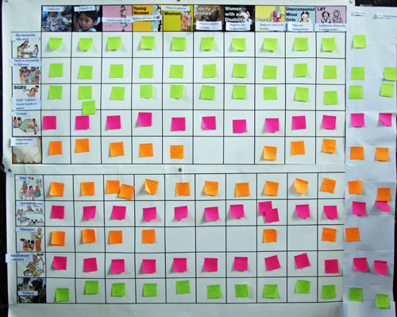
Matrix analysis
The matrix is a table of different ‘issues of concern’ or human rights (shown on the left side of the matrix), along with different categories of people in the community (shown along the top of the matrix).

Slide 24
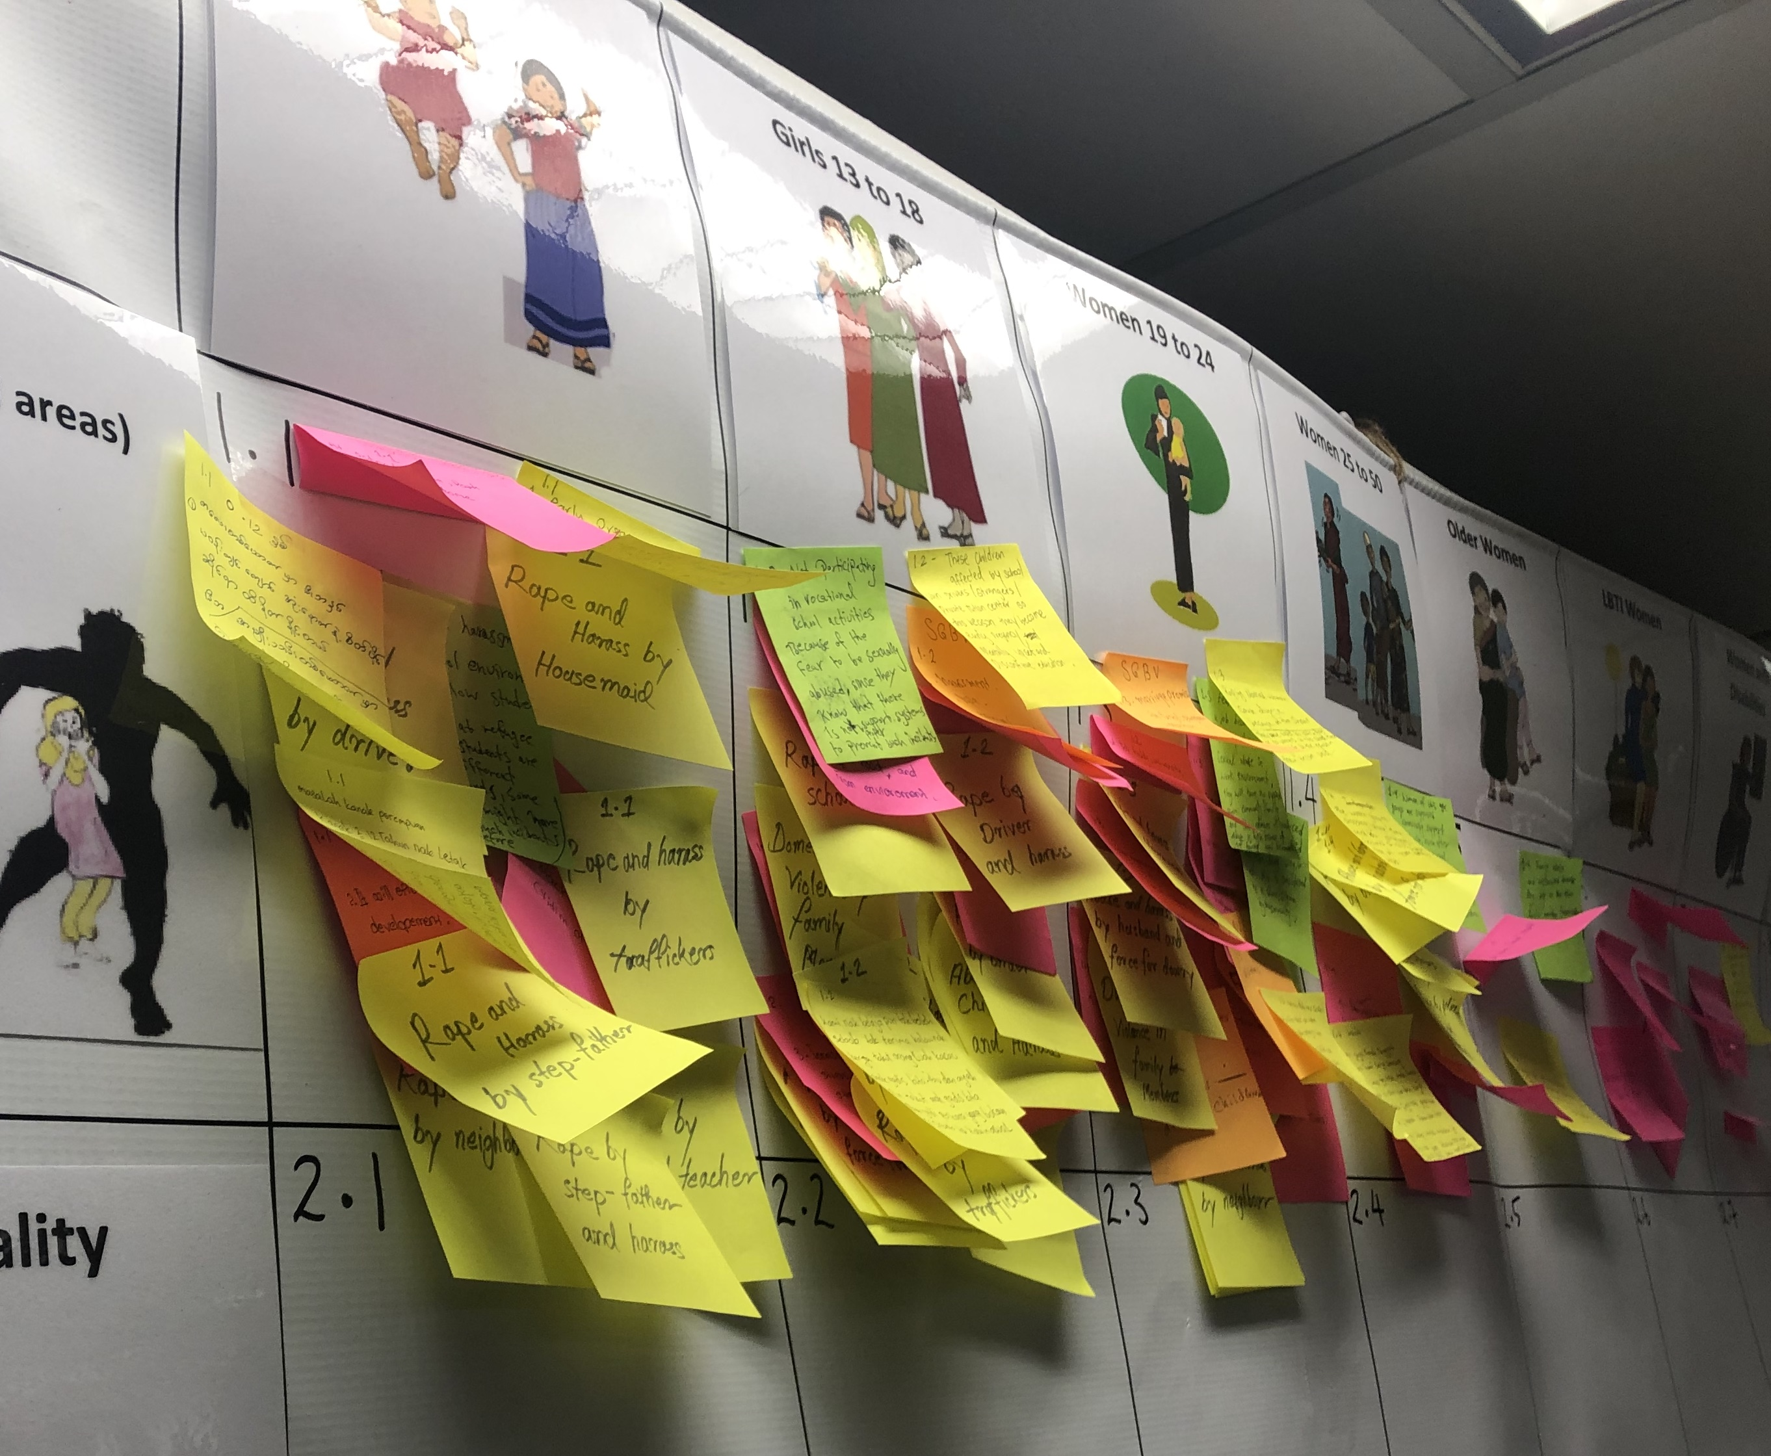
Matrix analysis
In small groups, participants discuss the different ways that each issue of concern impacts on each category of people. They write their responses on ‘post it’ notes, one for each issue they want to put in box in the matrix.

Slide 25
Matrix analysis
Each small group presents the points they have discussed to the rest of the participants, adding their sticky notes to the correct box on the matrix.

Slide 26
Group discussion/brainstorm
What benefits do you see for using the matrix when designing programs?
What challenges might you encounter?

Slide 27
Part 5: The Matrix: An intersectionality and AGD analytical tool
[UNHCR and UNSW]

Slide 28
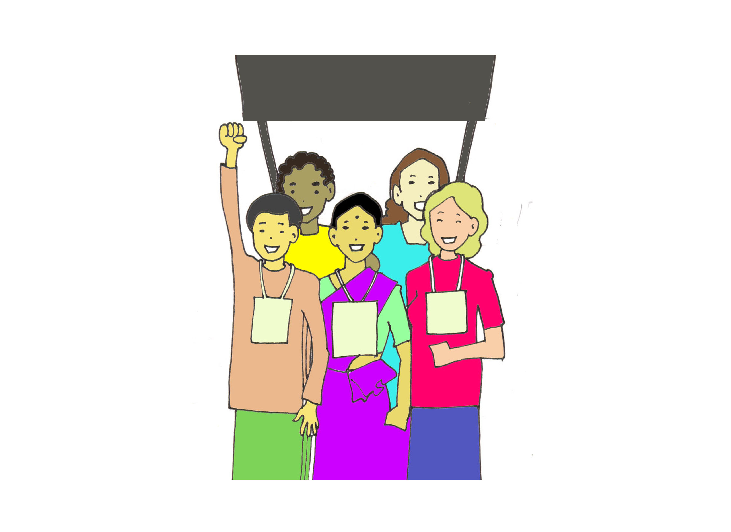
When should we use intersectionality and AGD?
All the time!
In all situations and in all of our work.
All programs must be based on a comprehensive AGD and intersectional analysis.
Draw on strengths and diversities to address discrimination.

Slide 29
Group discussion/ brainstorm
How might you apply this in your work?

Slide 30
The End. Congratulations We hope this helps you in your work.

